Slide 2

YPP 4th
bbv Software Services AG | Date

Slide 3




Presentation on Ho Chi Minh City Museum of History
bbv Software Services AG | Date: 08/05/2025

Slide 4
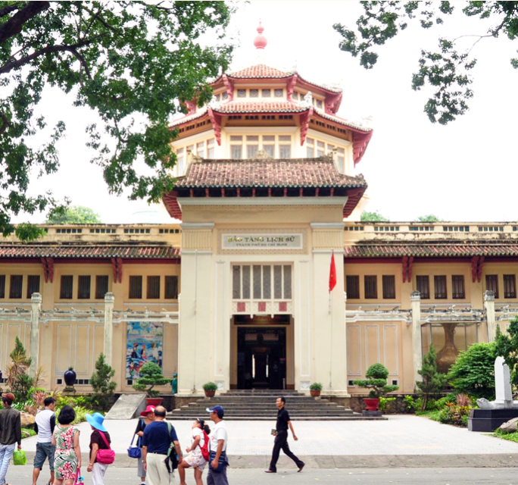
Agenda
Introduction
Vietnamese history
Culture and art
Special collection
Conclusion

Slide 5
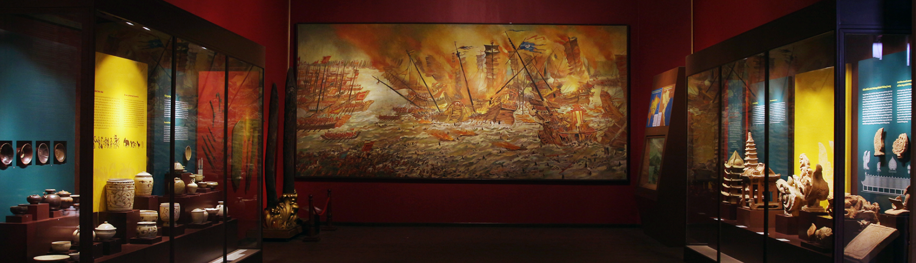

INTRODUCTION
What is Ho Chi Minh City Museum of History?

Slide 6
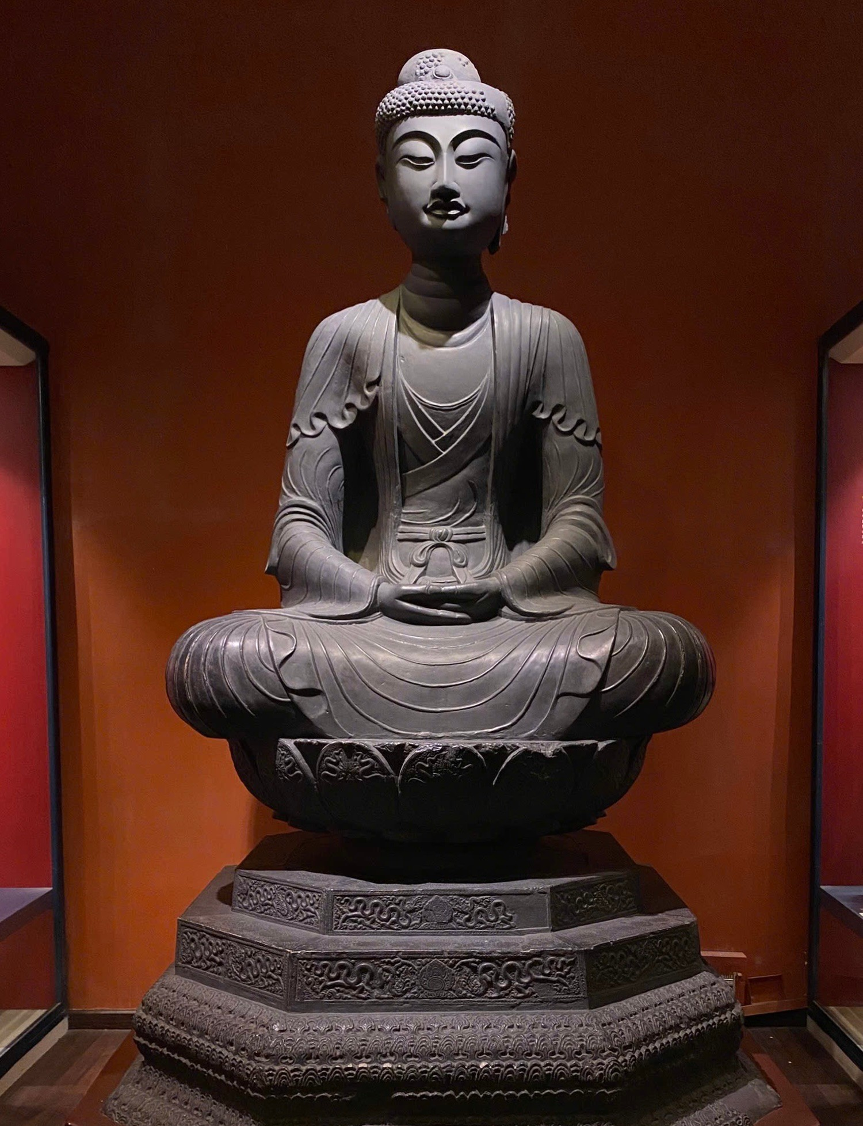
Introduction
What is Ho Chi Minh City Museum of History ?
a major historical and cultural museum
Overview:
Reflects the 18 major historical periods of Vietnam.
To preserve and display Vietnam’s cultural and historical heritage
Located at 2 Nguyễn Bỉnh Khiêm Street, Bến Nghé Ward, District 1, Ho Chi Minh City

Slide 7
VIET NAM HISTORY

Slide 8
Vietnamese historical timeline
TheFounding first period of and Struggling for Independence
Posterior Le - Mac, Trinh - Nguyen Lords dynasties
Nguyen dynasty
Ly dynasty
2000 – 938
1009 – 1225
1428 – 1788
1802 – 1945
year
30,000-2000
938 – 1009
1225 – 1407
1788 – 1802
Prehistoric period
Ngo - Dinh –
Early Le dynasties
Tran - Ho dynasties
Tay Son dynasties
BC
AD
Notes:
-- BOARDS TAB SCREEN
-- Get Avatar User
SELECT Id, PictureUrl
FROM Users usr
WHERE usr.Id = 1
-- Get the all starred boards by the specific user(id=8).
SELECT usb.UserId, brd.Id BoardId, brd.BackgroundUrl, brd.BoardName, brd.BoardStatus
FROM UserStarredBoard usb
JOIN Board brd ON brd.Id = usb.BoardId
WHERE UserId = 1 AND brd.BoardStatus = 'active' AND usb.StarredBoardsStatus = 1
ORDER BY usb.CreatedAt DESC;
-- recently viewed boards
-- Get 4 recently viewed boards by specific user(id=1)
SELECT TOP 4 brd.Id, brd.BoardName, brd.BackgroundUrl, uvh.AccessedAt, brd.BoardStatus
FROM Board brd
JOIN UserViewHistory uvh ON uvh.OwnerId = brd.Id
JOIN OwnerType owt ON owt.Id = uvh.OwnerTypeId
WHERE uvh.UserId = 5 AND owt.OwnerTypeValue = 'BOARD' AND brd.BoardStatus = 'active'
ORDER BY uvh.AccessedAt DESC;
-- Get all workspace that specific User(id=1) is member
SELECT wsp.Id WorkspaceId, wsp.WorkspaceName, wsp.LogoUrl
FROM Workspace wsp
JOIN Members meb ON meb.OwnerId = wsp.Id
JOIN OwnerType owt ON owt.Id = meb.OwnerTypeId
JOIN Users usr ON usr.Id = meb.UserId
WHERE owt.OwnerTypeValue = 'WORKSPACE' AND meb.UserId = 1
ORDER BY wsp.CreatedAt;
-- Get list all board that specific User(i=1) is member for specific Workspace(id=1)
SELECT brd.Id AS BoardId, brd.BoardName AS BoardName, wsp.WorkspaceName AS WorkspaceName, brd.BackgroundUrl
FROM Board brd
JOIN Members mbr ON mbr.OwnerId = brd.Id
JOIN OwnerType owt ON owt.Id = mbr.OwnerTypeId
JOIN Workspace wsp ON brd.WorkspaceId = wsp.Id
JOIN Users usr ON mbr.UserId = usr.Id
WHERE usr.Id = 1 AND owt.OwnerTypeValue = 'BOARD' AND wsp.Id = 1
ORDER BY brd.CreatedAt;

Slide 9
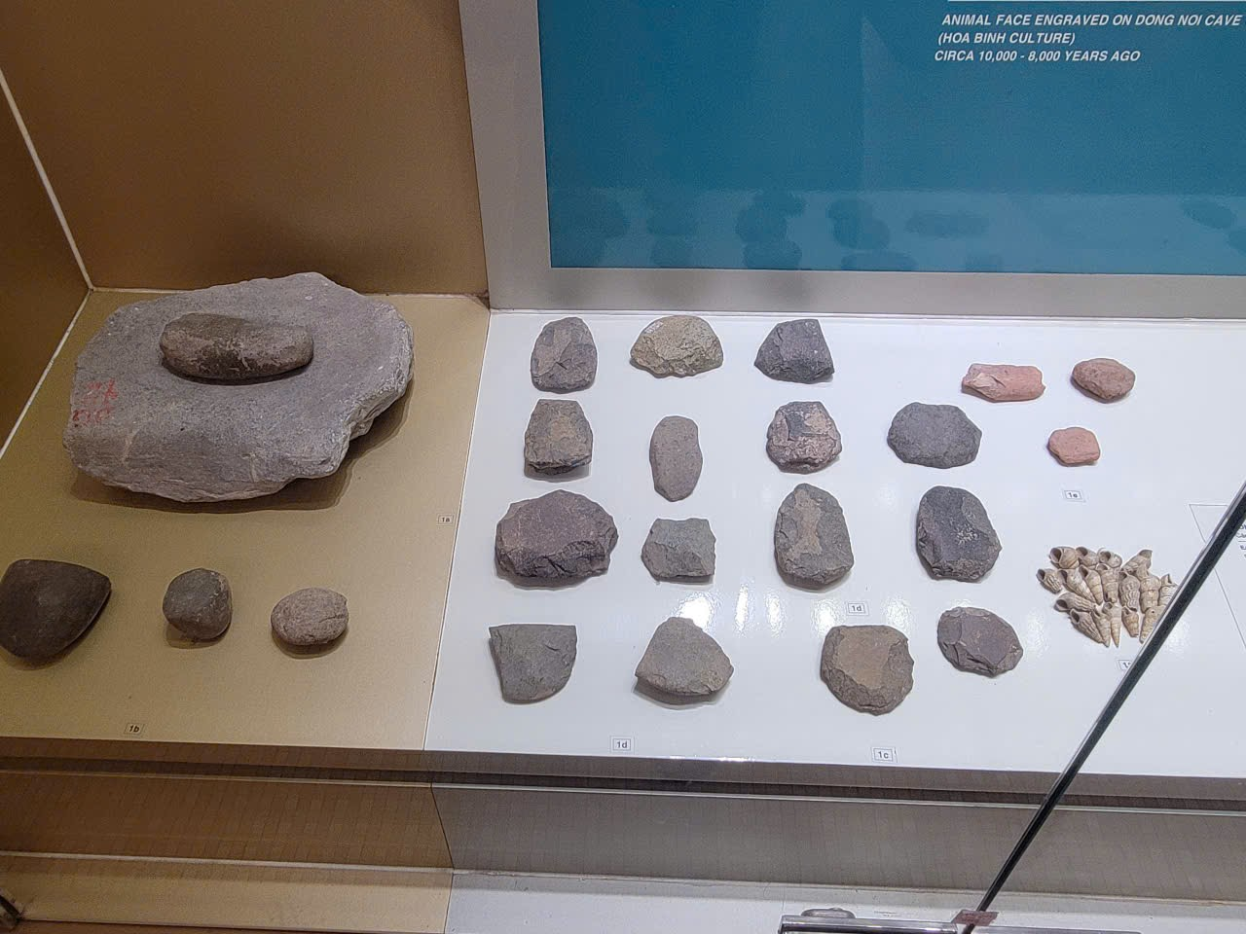
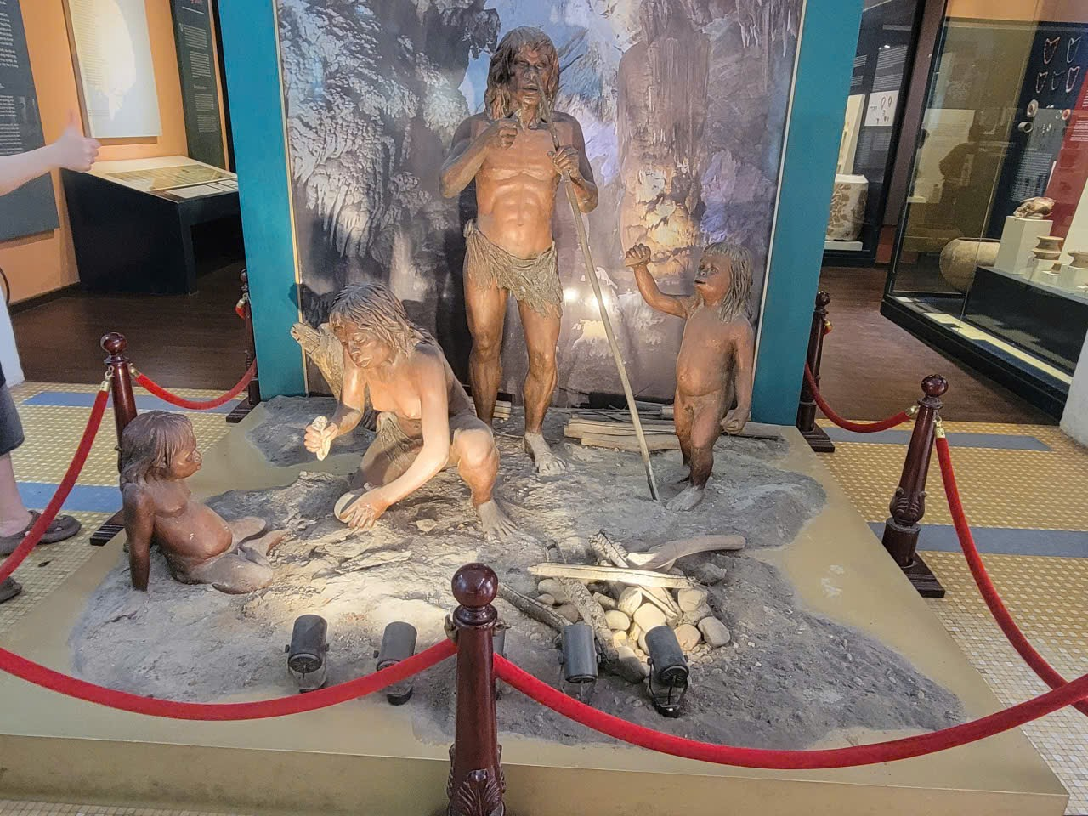
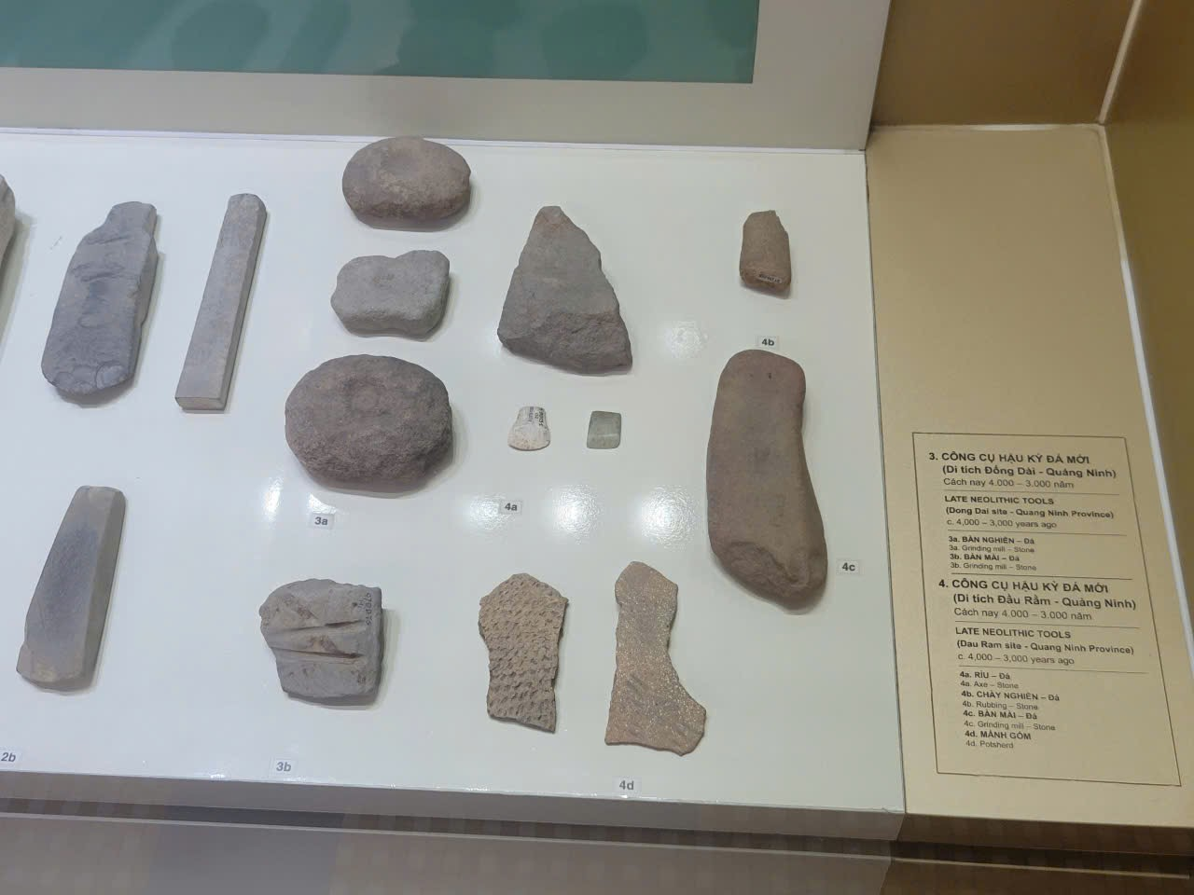
Prehistoric period
Time: 30,000 BC - 2000 BC
Characteristics: Humans appear, hunt - gather, stone tools.

Slide 10
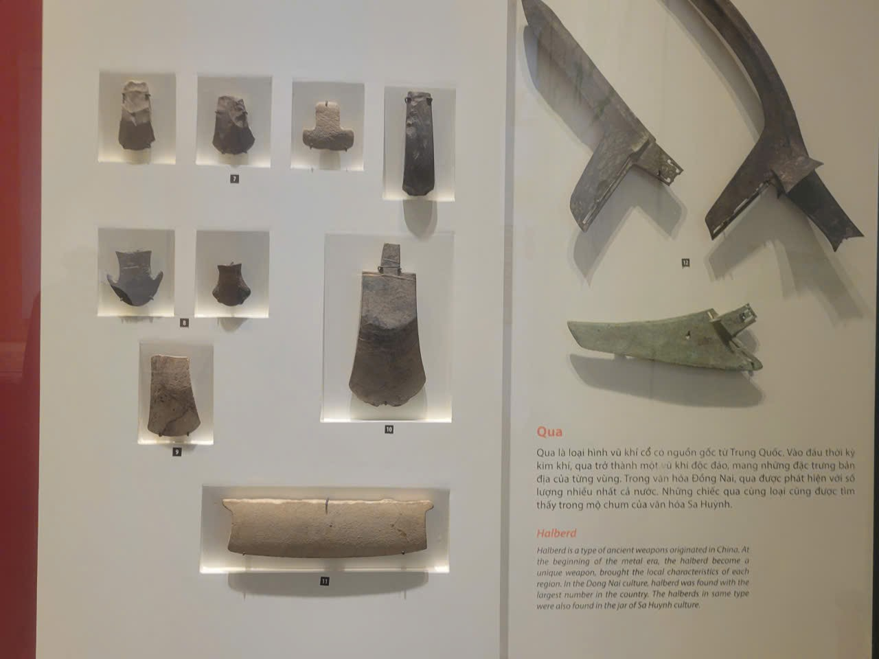
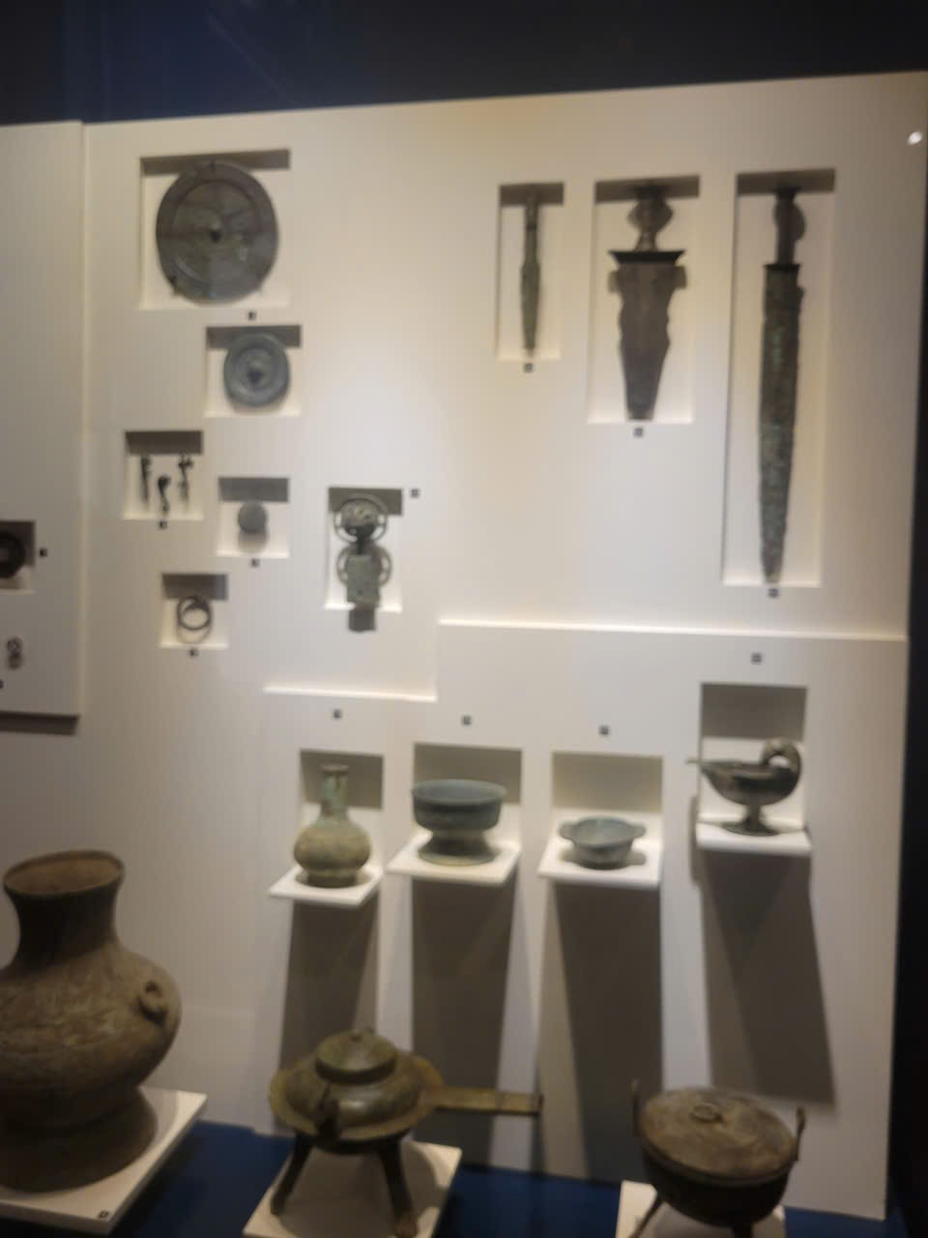
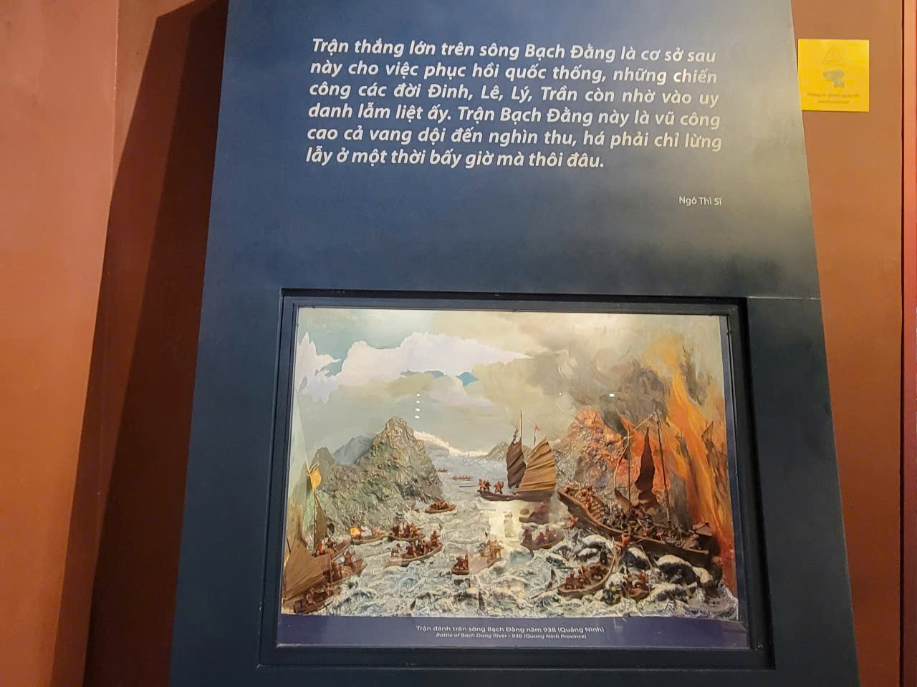
The first period of Founding and Struggling for Independence
Time: 2000 BC – 938 AD
Characteristics:
Establishment of the first states: Van Lang and later Au Lac.
Development of wet rice agriculture and bronze casting (Dong Son culture).
Construction of Co Loa Citadel, an early fortified city.

Slide 11
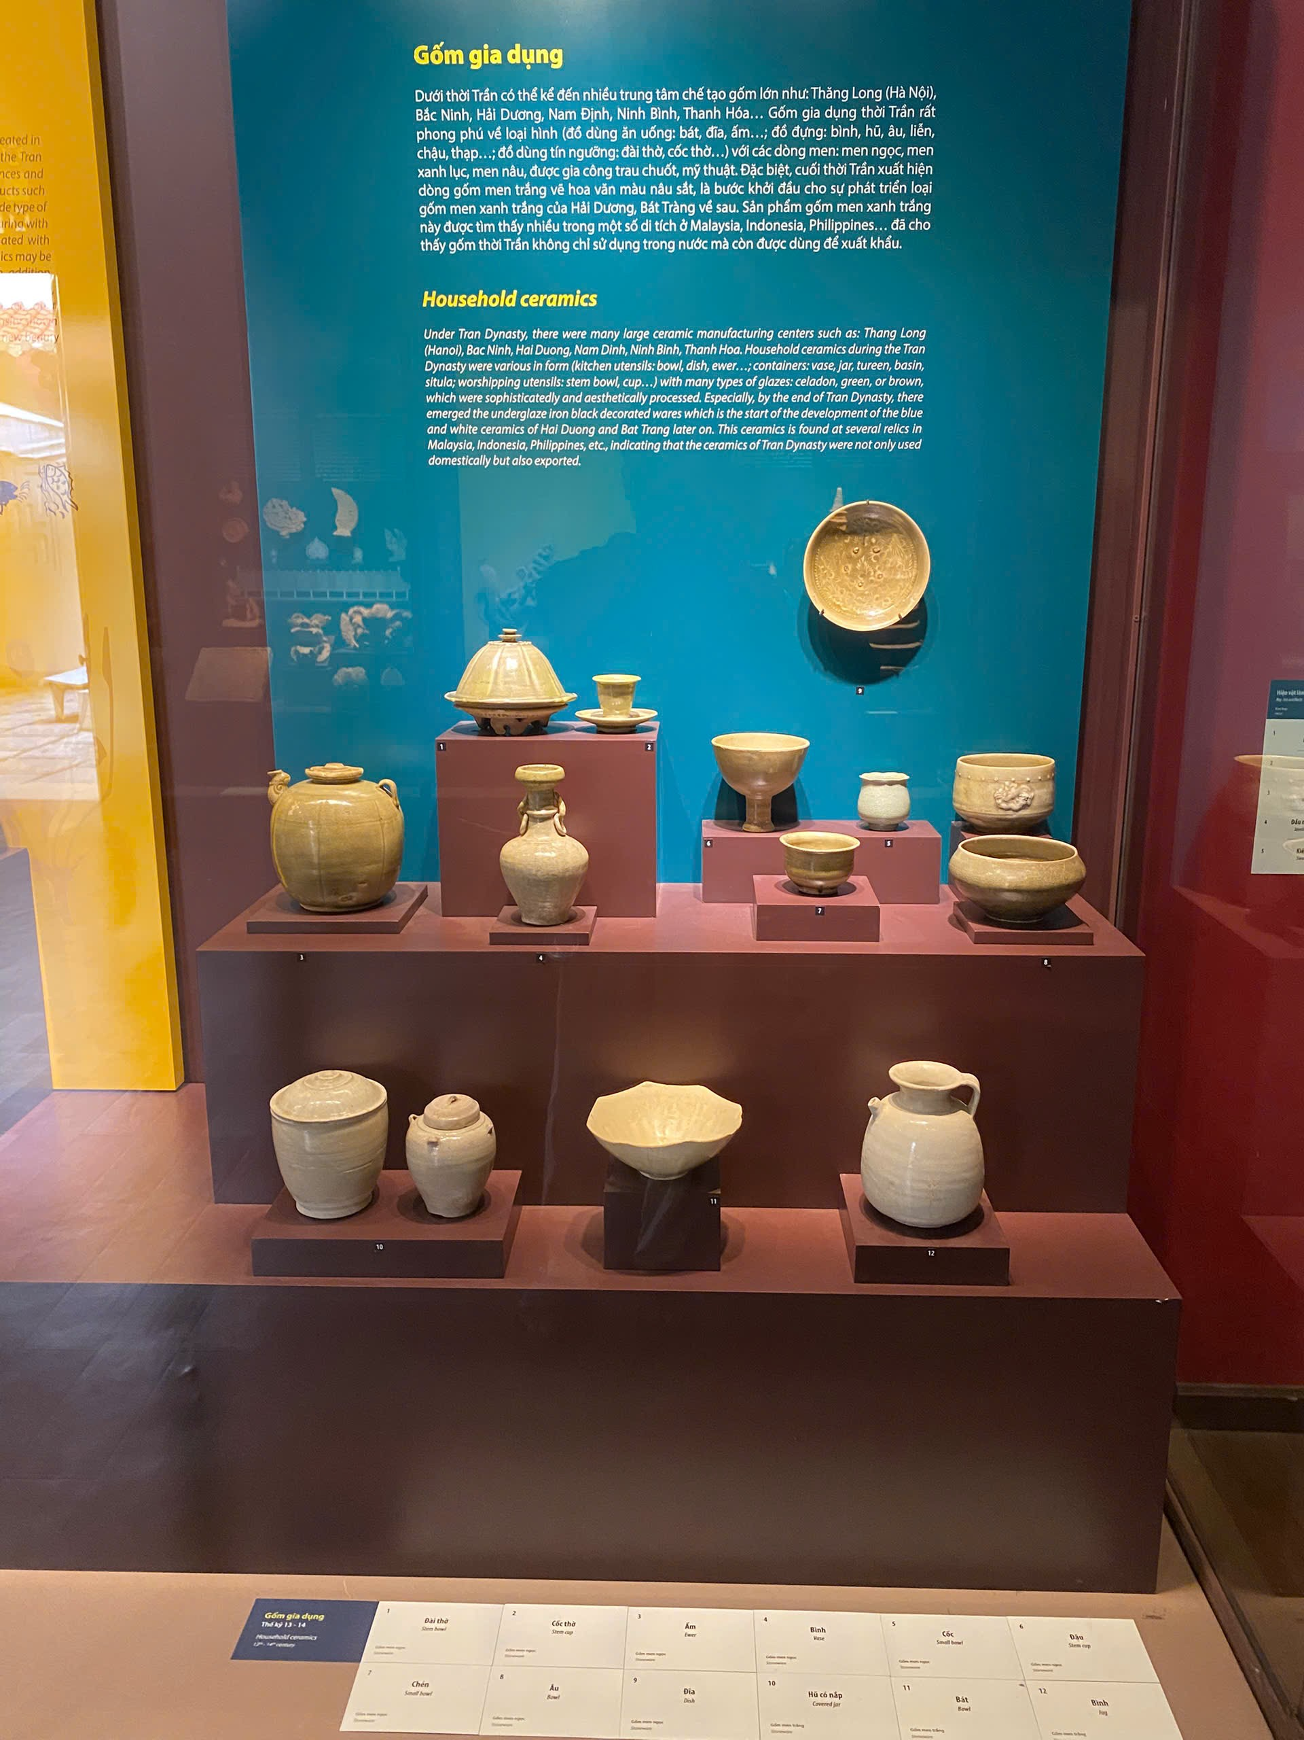
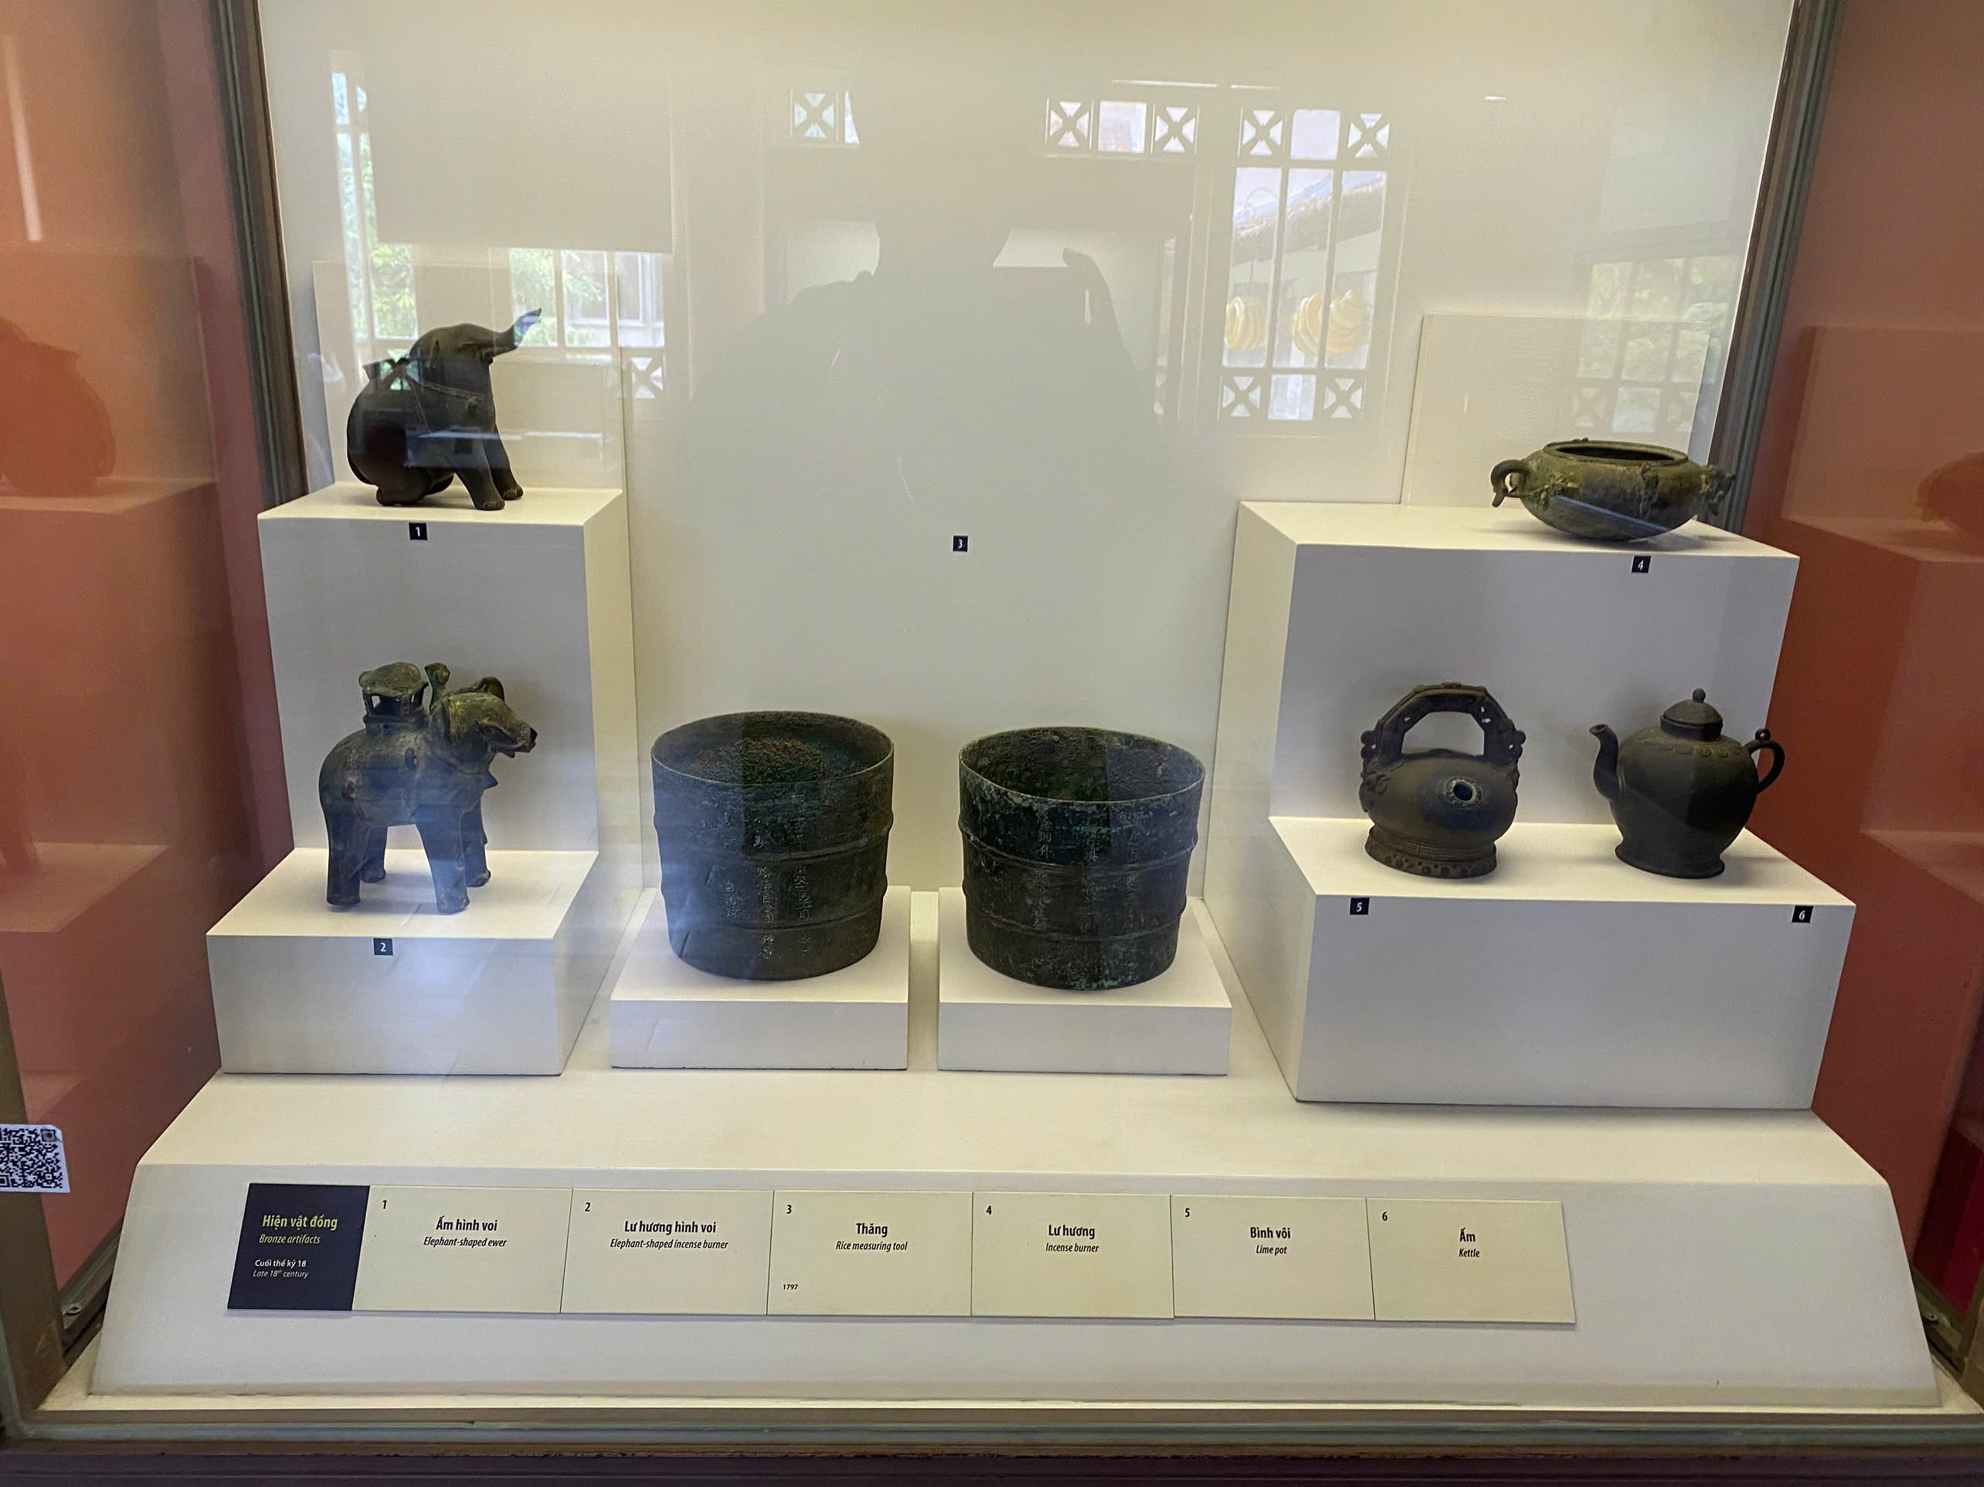
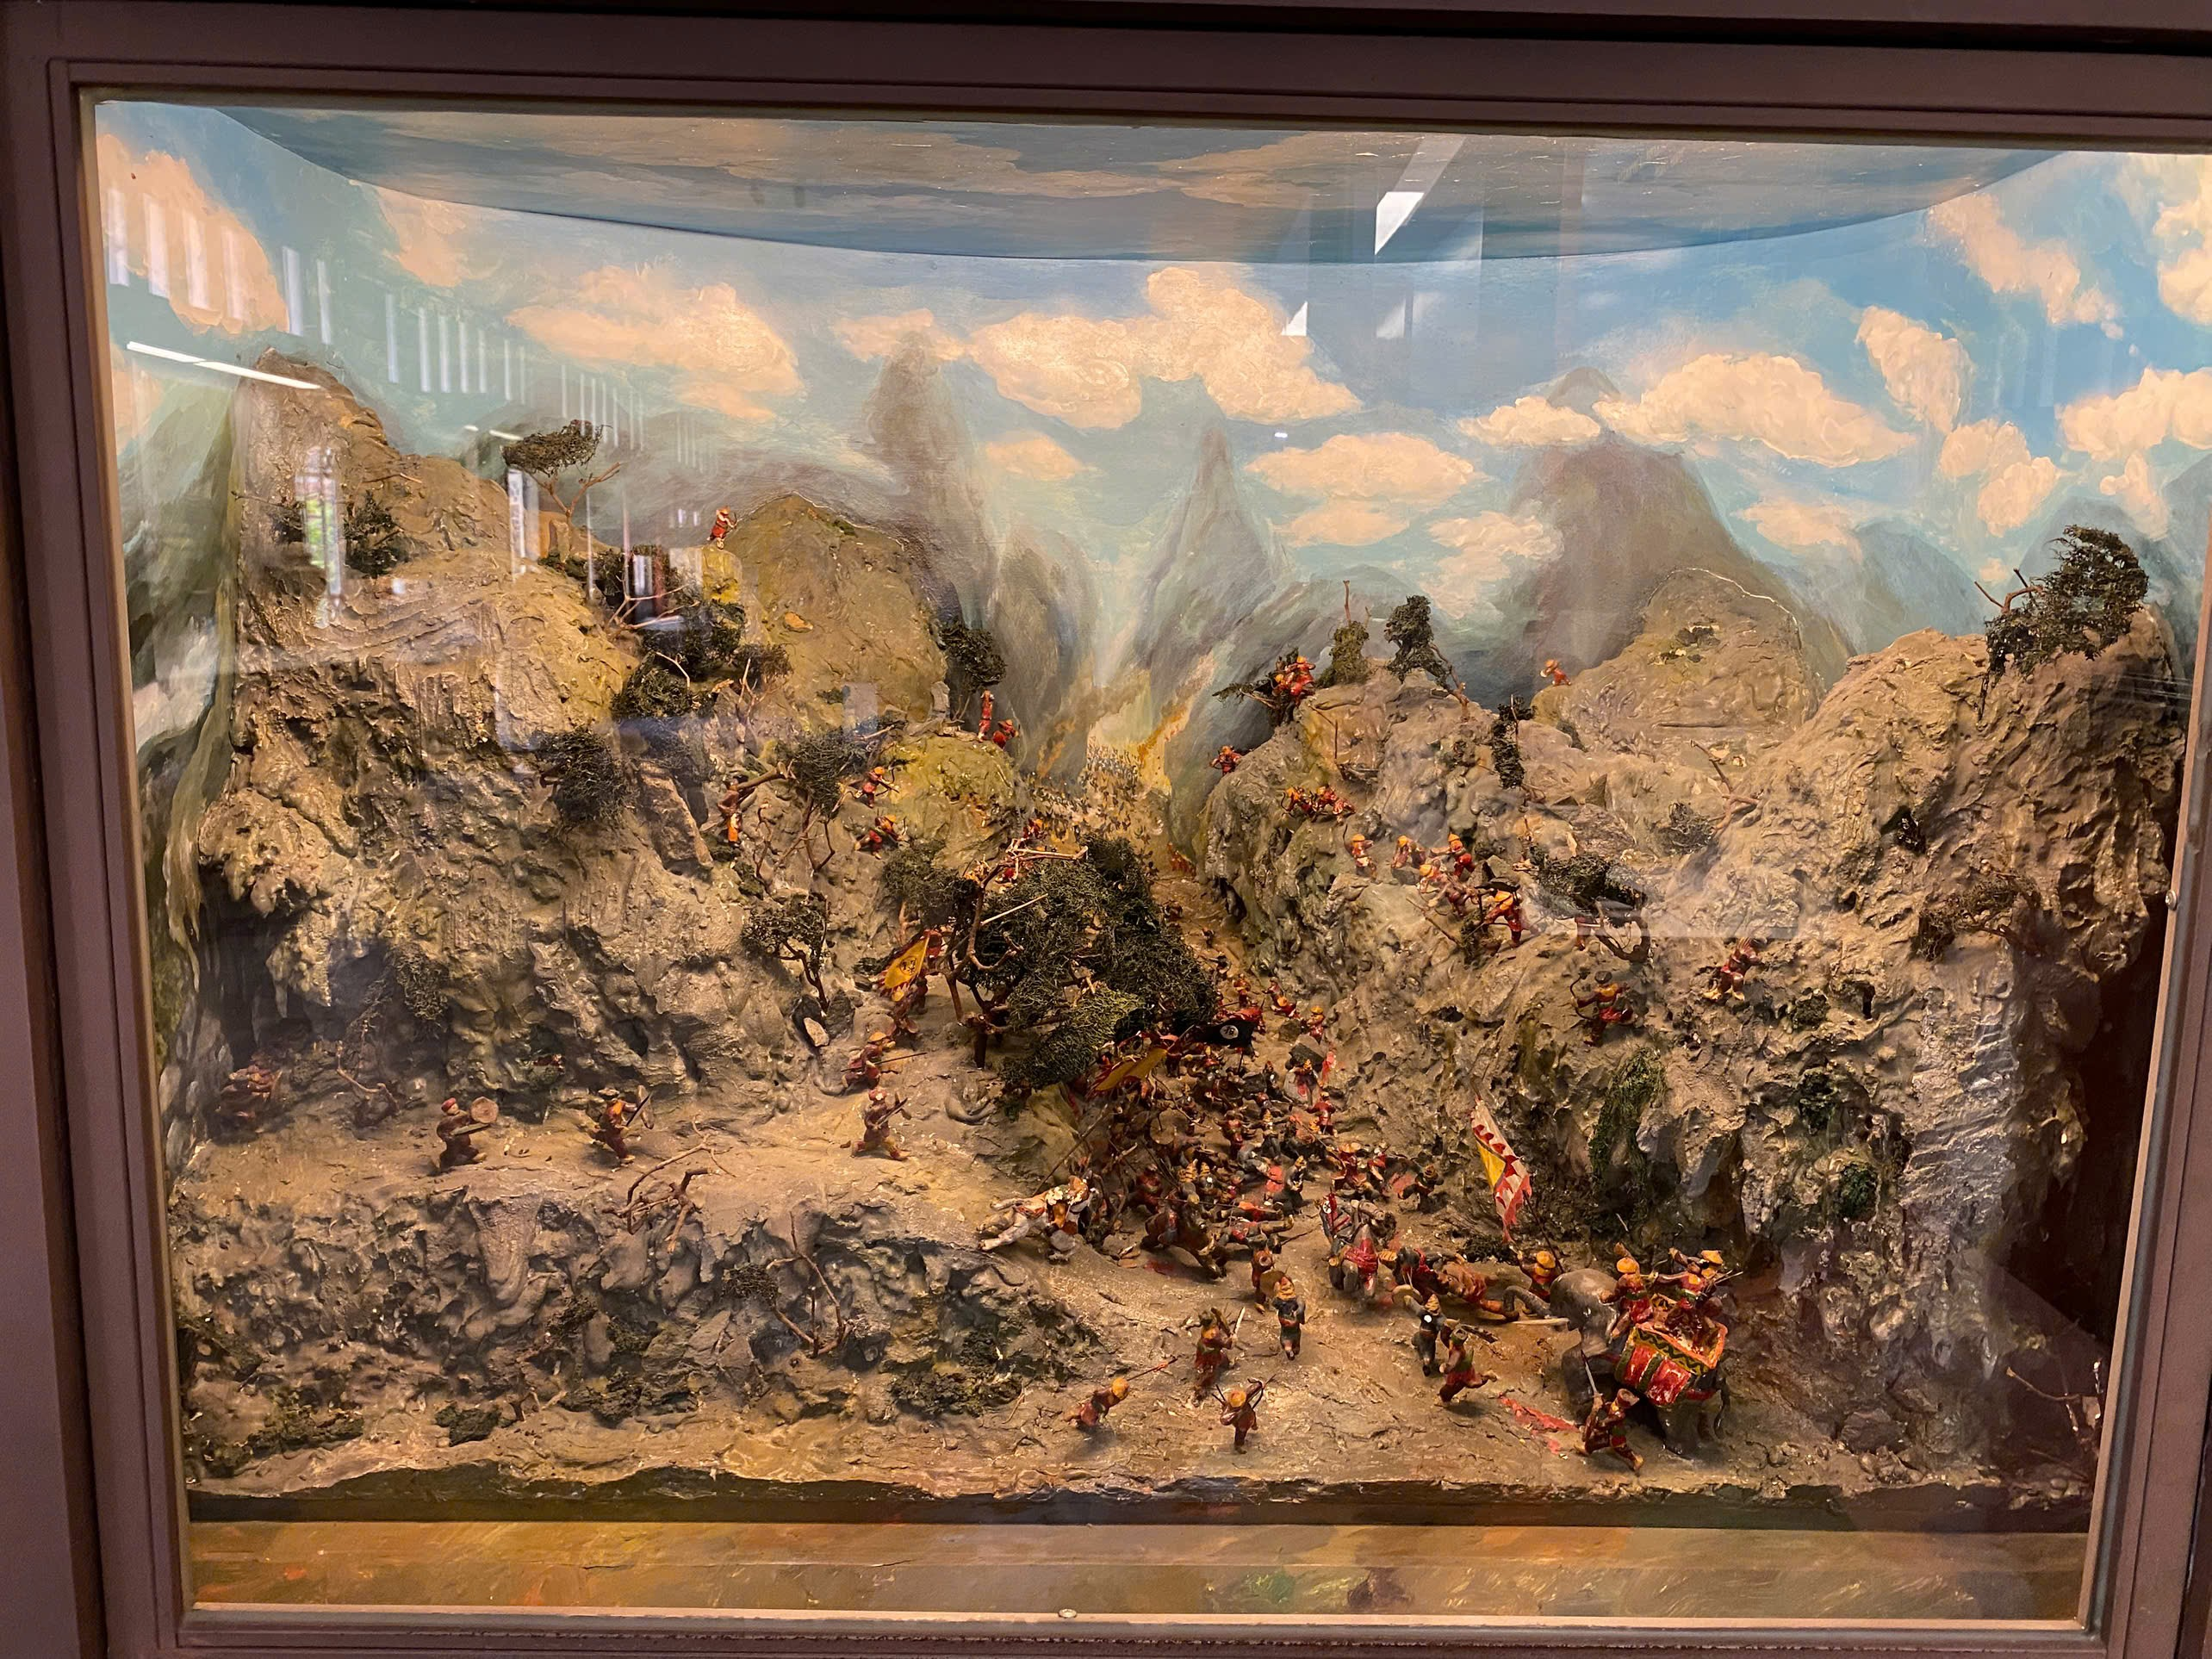
Ngo - Dinh - Early Le dynasties
Time: 938 - 1009
Characteristics: Ngo Quyen ended about 1,000 years of struggle Chinese. Dinh Bo Linh → 12 Lords Rebellion and founded the Dinh dynasty (968), naming the nation Dai Co Viet.
Notes:
Triều Ngô, Đinh và Tiền Lê là ba triều đại đầu tiên trong lịch sử phong kiến Việt Nam, lần lượt cai trị sau khi chấm dứt thời kỳ Bắc thuộc và trước khi nhà Lý lên ngôi. Triều Ngô (nhà Ngô) do Ngô Quyền thành lập, đánh dấu sự độc lập của Việt Nam. Triều Đinh do Đinh Bộ Lĩnh sáng lập, thống nhất đất nước sau loạn 12 sứ quân, và triều Tiền Lê do Lê Hoàn (Lê Đại Hành) thành lập sau khi Đinh Toàn nhường ngôi cho ông, đánh bại quân Tống xâm lược.

Slide 12
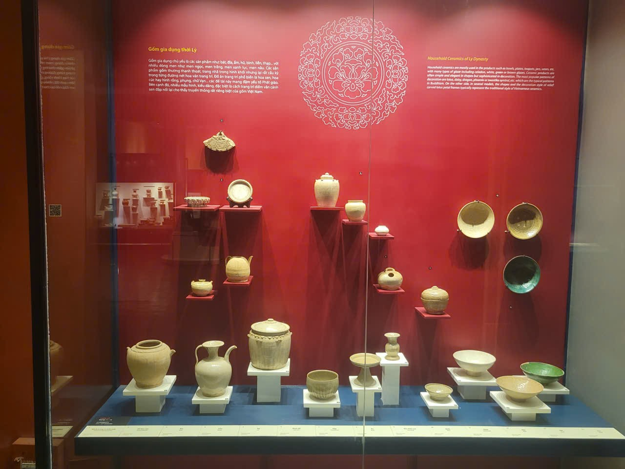
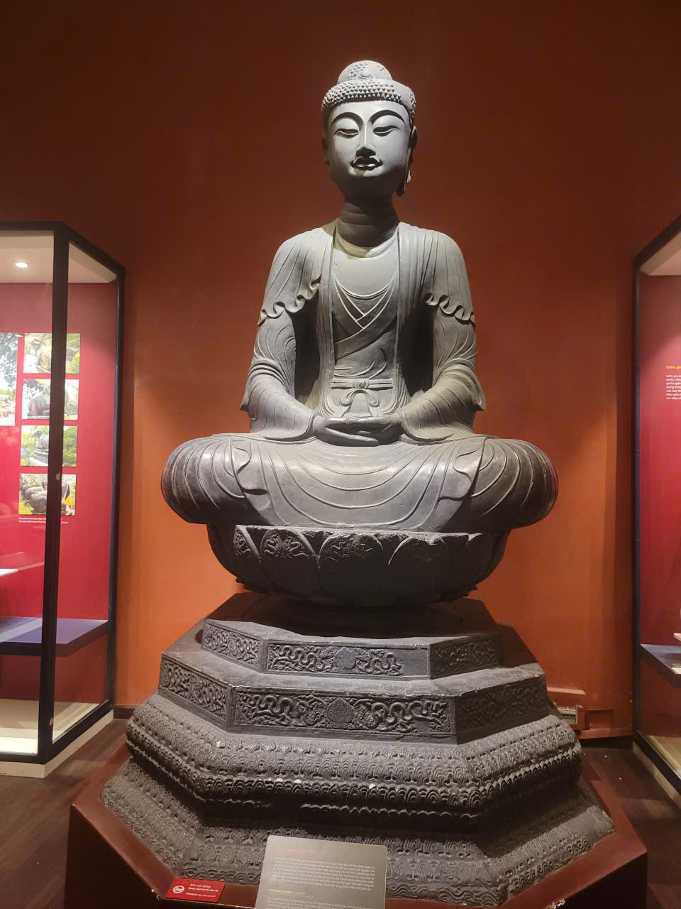
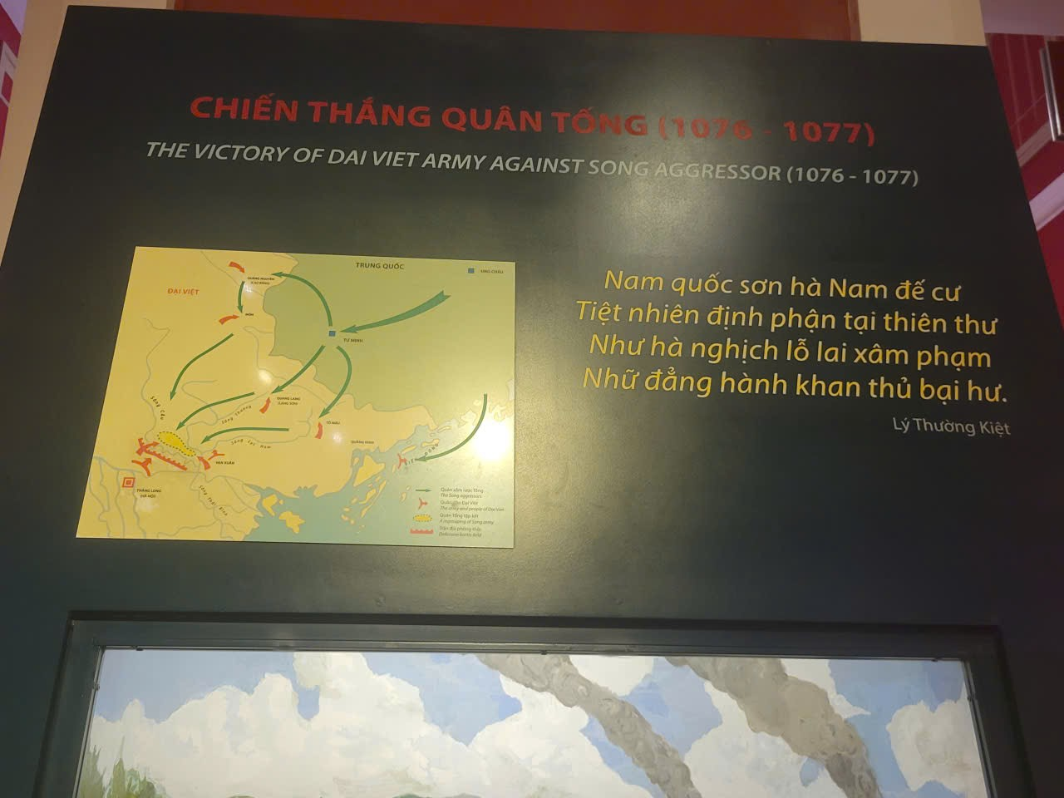
Ly dynasty
Time: 1009 - 1225
Characteristics: Thang Long capital(Hanoi) in 1010 , Buddhist culture developed.

Slide 13
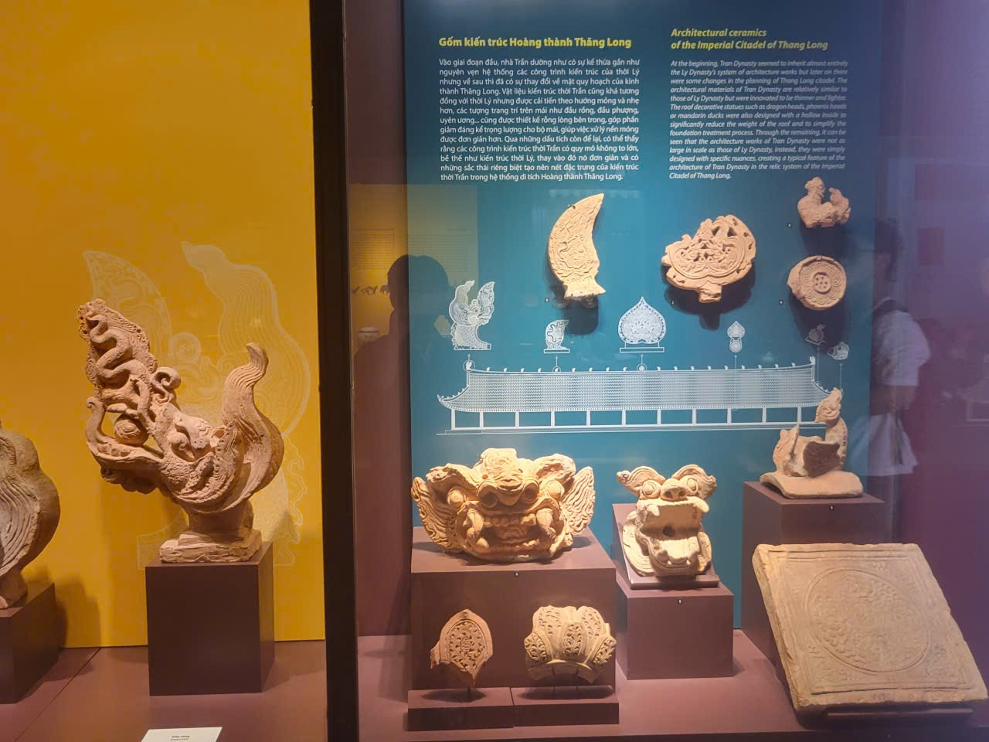
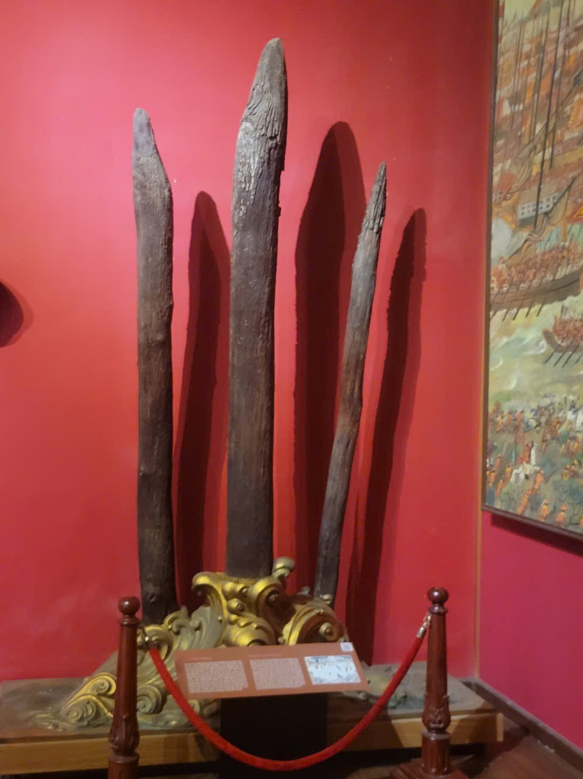
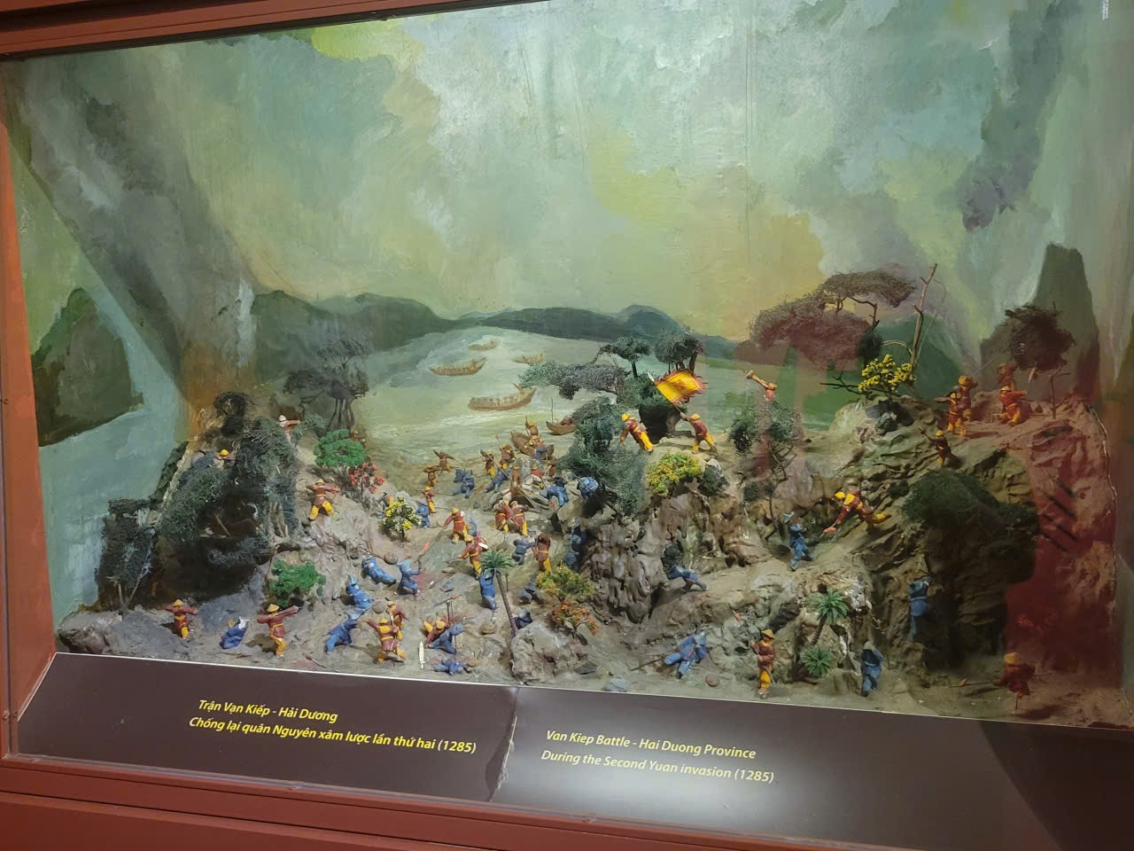
Tran - Ho dynasties
Time: 1225 – 1407
Characteristics: resistance against Nguyen Mong(1258, 1285, 1288), economic and cultural development.

Slide 14
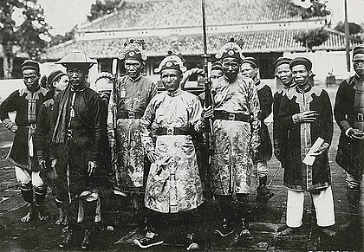
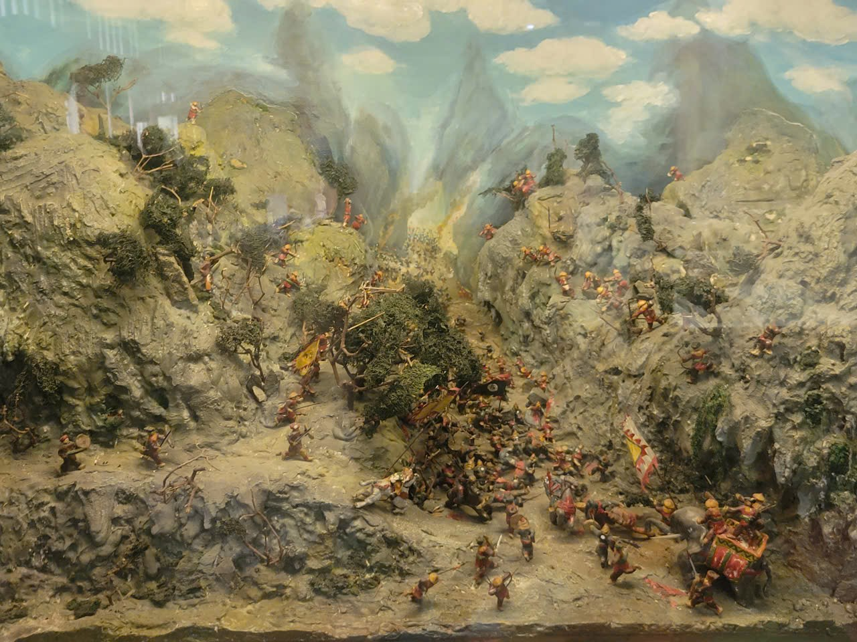
Posterior Le - Mac, Trinh - Nguyen Lords dynasties
Time: 1428 – 1788
Characteristics: Le dynasty develop, Trinh – Nguyen struggle.

Slide 15
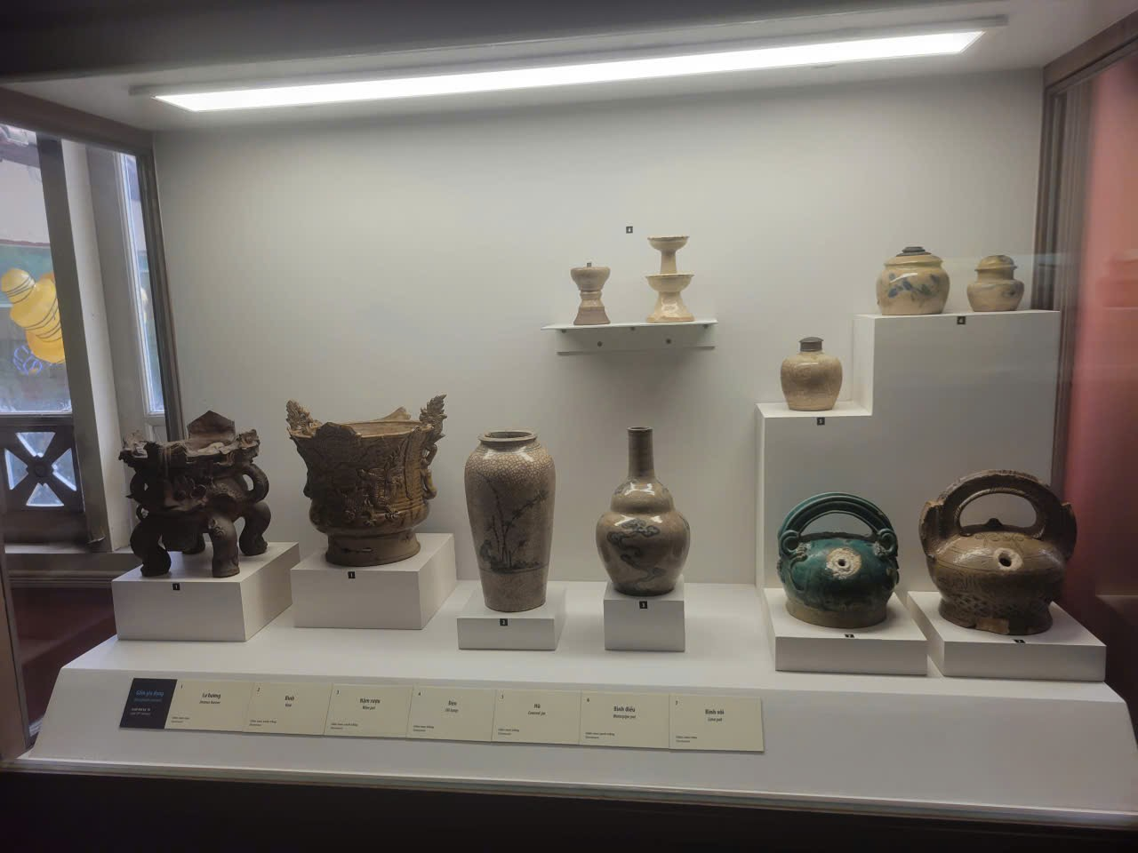
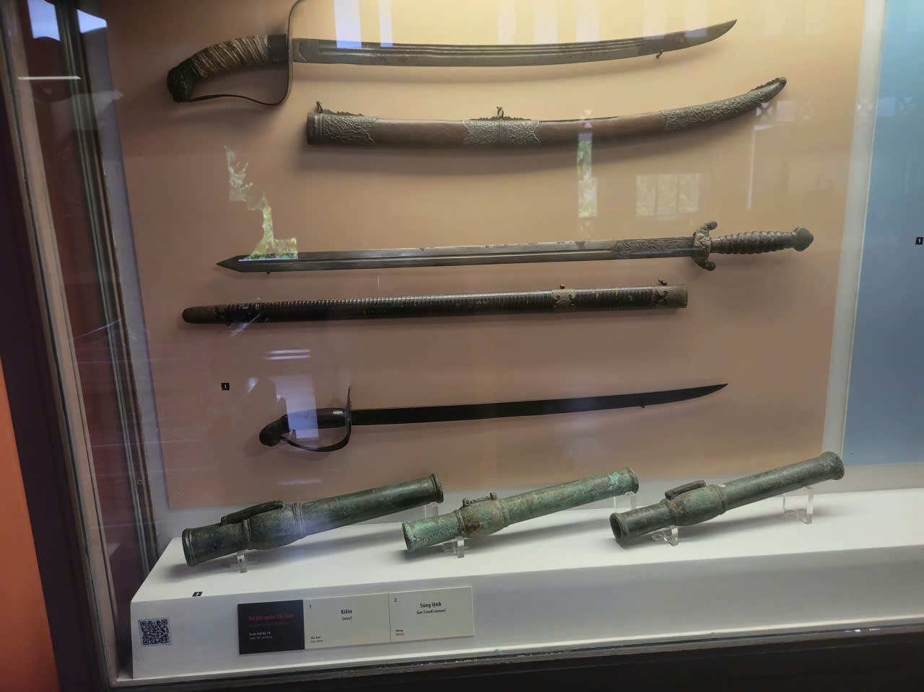
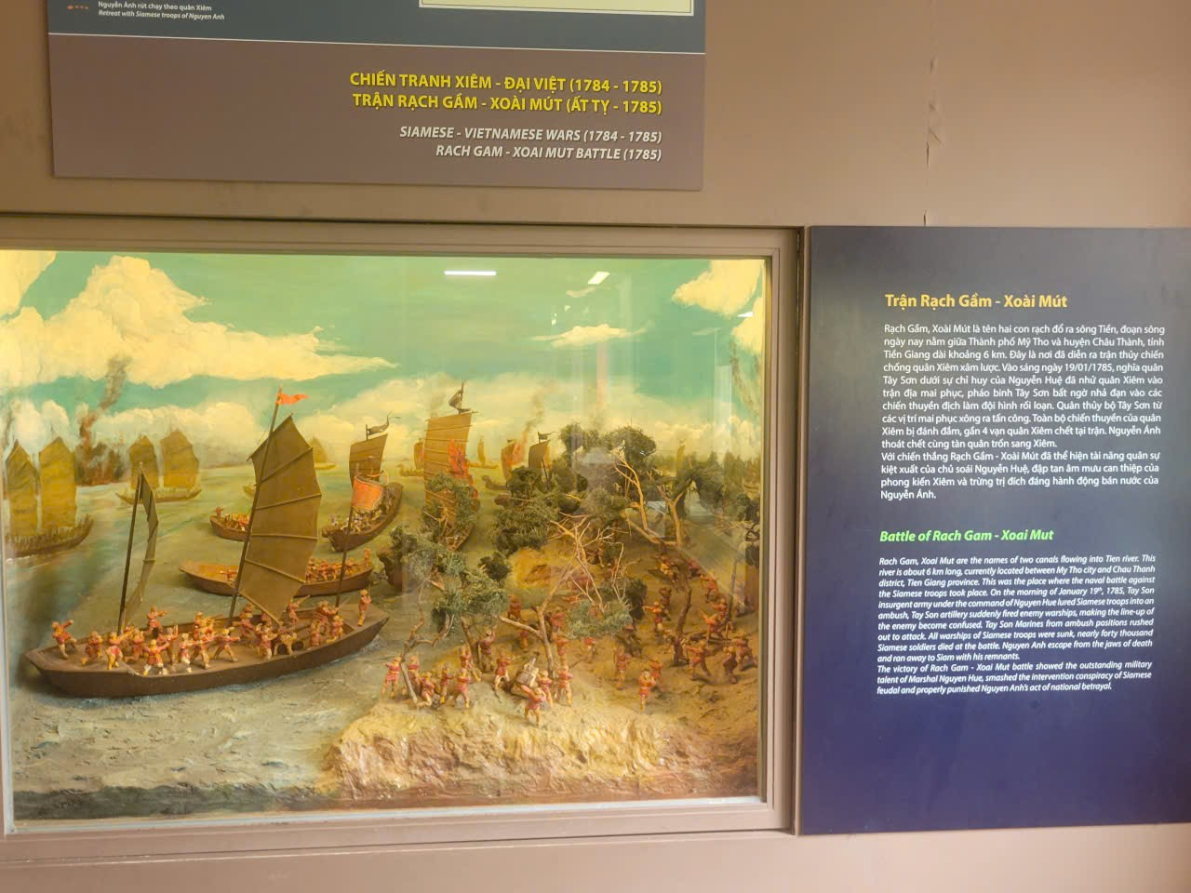
Tay Son dynasty
Time: 1778 – 1802
Characteristics: Farmers uprising, Quang Trung Dai destroyed the Qing army.

Slide 16
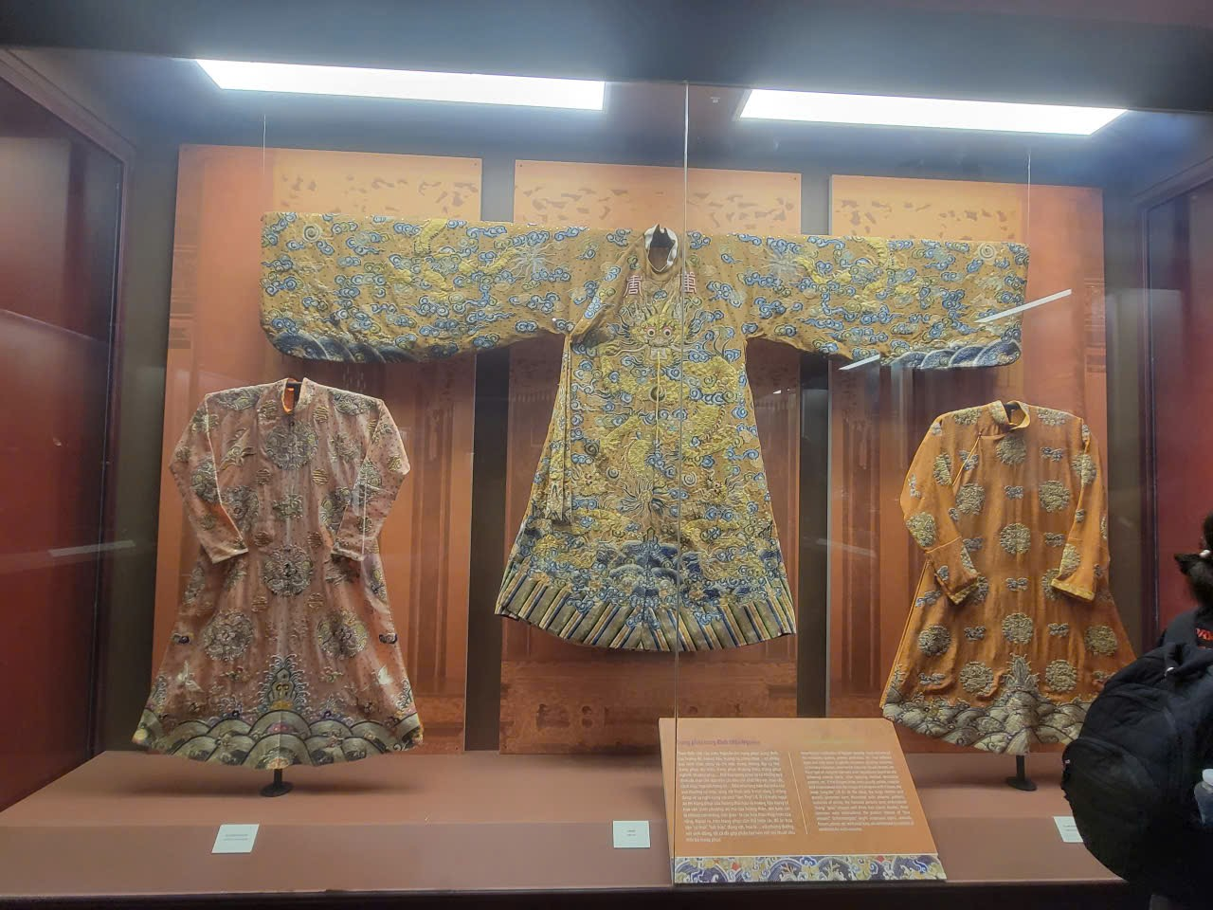
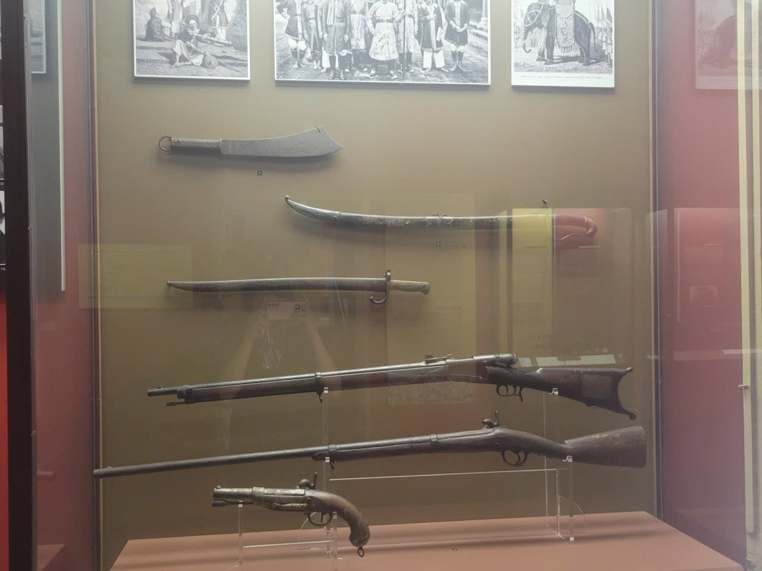
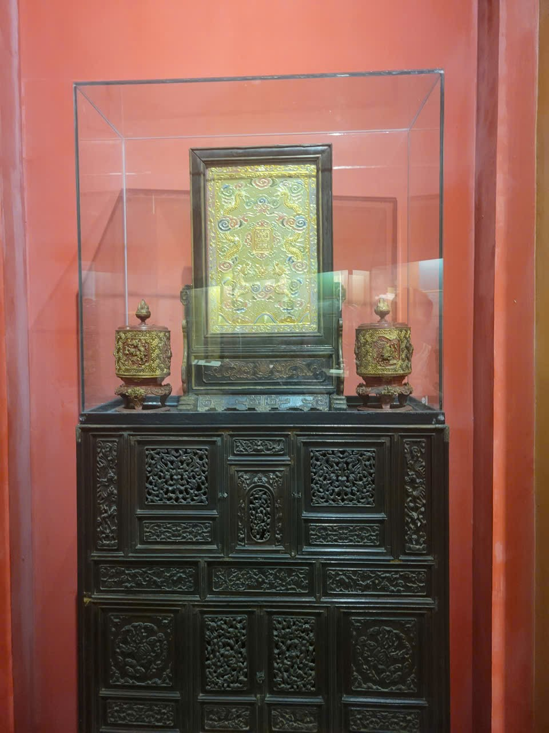
Nguyen dynasty
Time: 1802 - 1945
Characteristics: The last feudal dynasty, Western exchange.

Slide 17
Vietnamese culture timeline
Oc Eo culture
Stone carvings of Cambodia
Buddhist Statues of Asian countries
I - VII
IX - XIII
VII - now
century
0
now
II-XV
XV-XVIII
XIX-now
Champa culture
Maritime trades – Shipwrecked ceramics
Minority cultures from Southern provinces
Notes:
-- BOARDS TAB SCREEN
-- Get Avatar User
SELECT Id, PictureUrl
FROM Users usr
WHERE usr.Id = 1
-- Get the all starred boards by the specific user(id=8).
SELECT usb.UserId, brd.Id BoardId, brd.BackgroundUrl, brd.BoardName, brd.BoardStatus
FROM UserStarredBoard usb
JOIN Board brd ON brd.Id = usb.BoardId
WHERE UserId = 1 AND brd.BoardStatus = 'active' AND usb.StarredBoardsStatus = 1
ORDER BY usb.CreatedAt DESC;
-- recently viewed boards
-- Get 4 recently viewed boards by specific user(id=1)
SELECT TOP 4 brd.Id, brd.BoardName, brd.BackgroundUrl, uvh.AccessedAt, brd.BoardStatus
FROM Board brd
JOIN UserViewHistory uvh ON uvh.OwnerId = brd.Id
JOIN OwnerType owt ON owt.Id = uvh.OwnerTypeId
WHERE uvh.UserId = 5 AND owt.OwnerTypeValue = 'BOARD' AND brd.BoardStatus = 'active'
ORDER BY uvh.AccessedAt DESC;
-- Get all workspace that specific User(id=1) is member
SELECT wsp.Id WorkspaceId, wsp.WorkspaceName, wsp.LogoUrl
FROM Workspace wsp
JOIN Members meb ON meb.OwnerId = wsp.Id
JOIN OwnerType owt ON owt.Id = meb.OwnerTypeId
JOIN Users usr ON usr.Id = meb.UserId
WHERE owt.OwnerTypeValue = 'WORKSPACE' AND meb.UserId = 1
ORDER BY wsp.CreatedAt;
-- Get list all board that specific User(i=1) is member for specific Workspace(id=1)
SELECT brd.Id AS BoardId, brd.BoardName AS BoardName, wsp.WorkspaceName AS WorkspaceName, brd.BackgroundUrl
FROM Board brd
JOIN Members mbr ON mbr.OwnerId = brd.Id
JOIN OwnerType owt ON owt.Id = mbr.OwnerTypeId
JOIN Workspace wsp ON brd.WorkspaceId = wsp.Id
JOIN Users usr ON mbr.UserId = usr.Id
WHERE usr.Id = 1 AND owt.OwnerTypeValue = 'BOARD' AND wsp.Id = 1
ORDER BY brd.CreatedAt;

Slide 18
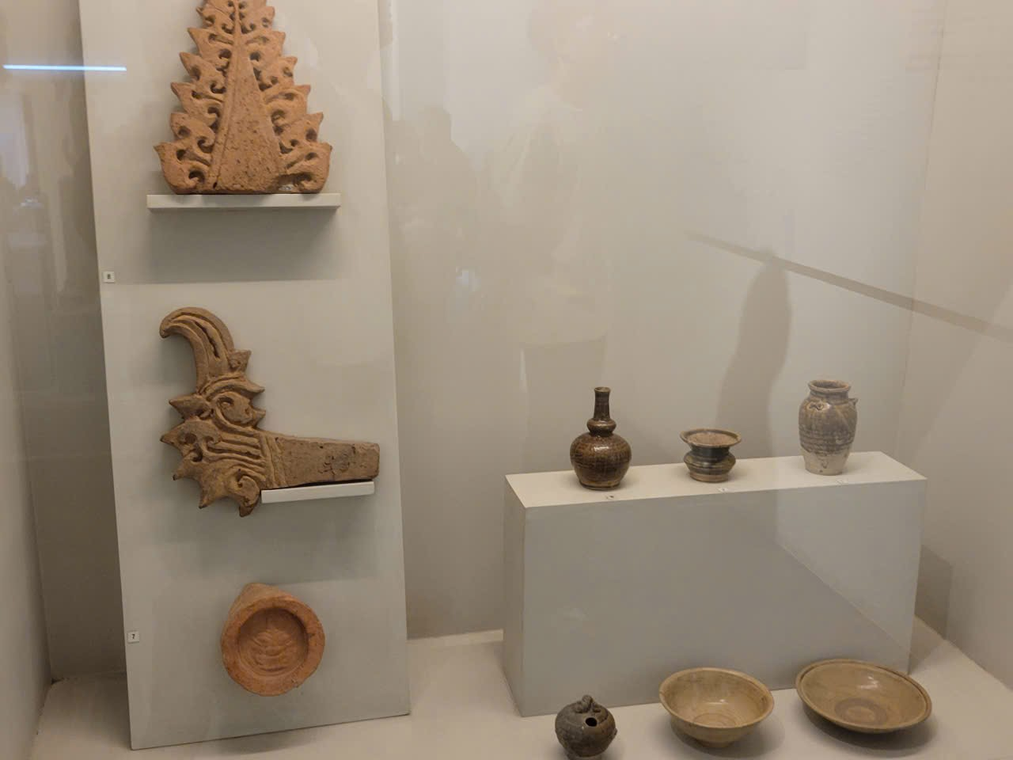
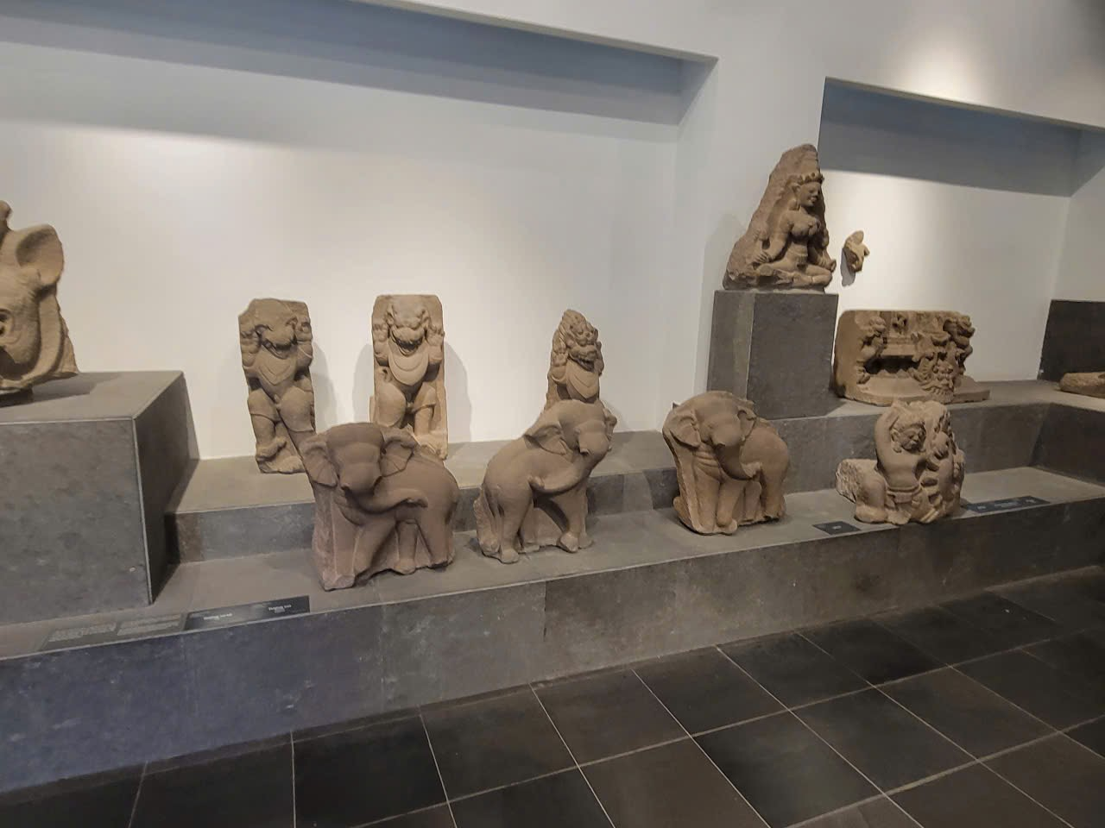
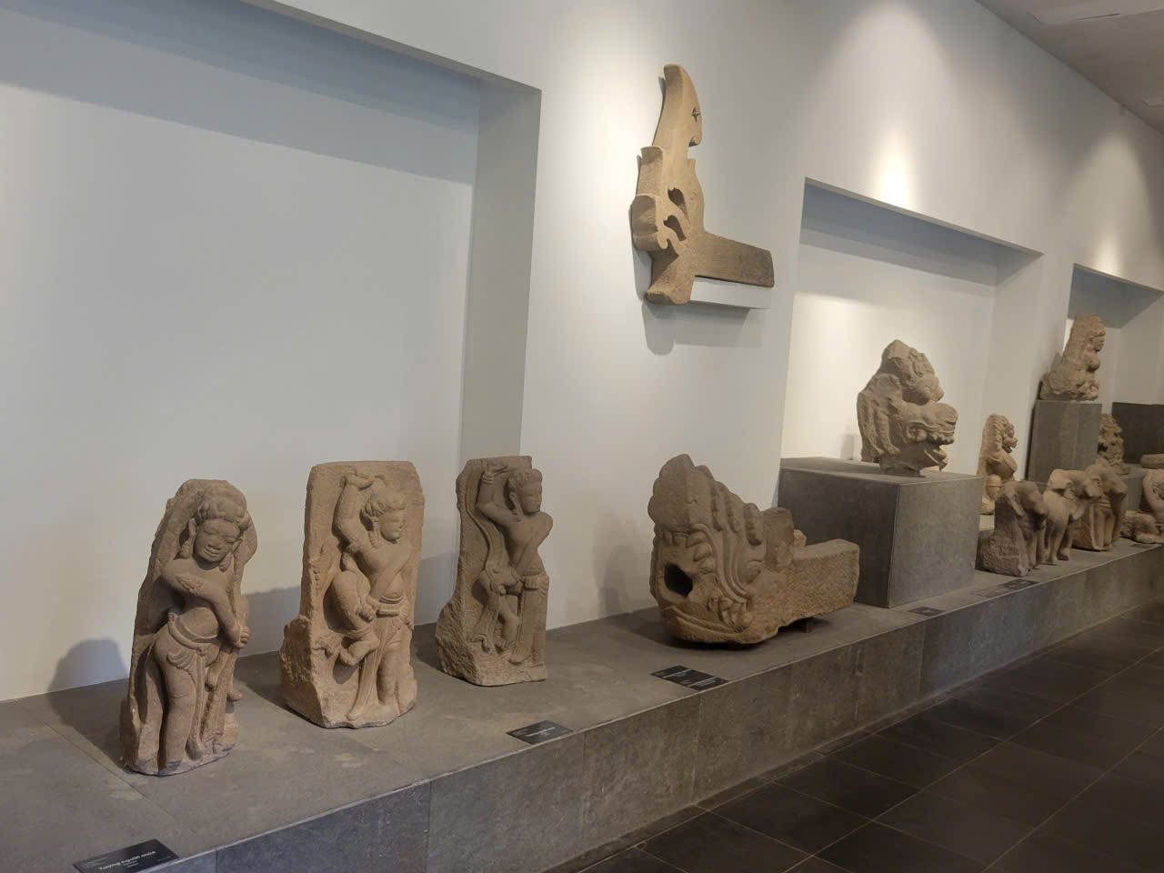
Champa culture
Time: II century – XIX
Characteristics: Influence of Hinduism, Temple architecture.

Slide 19
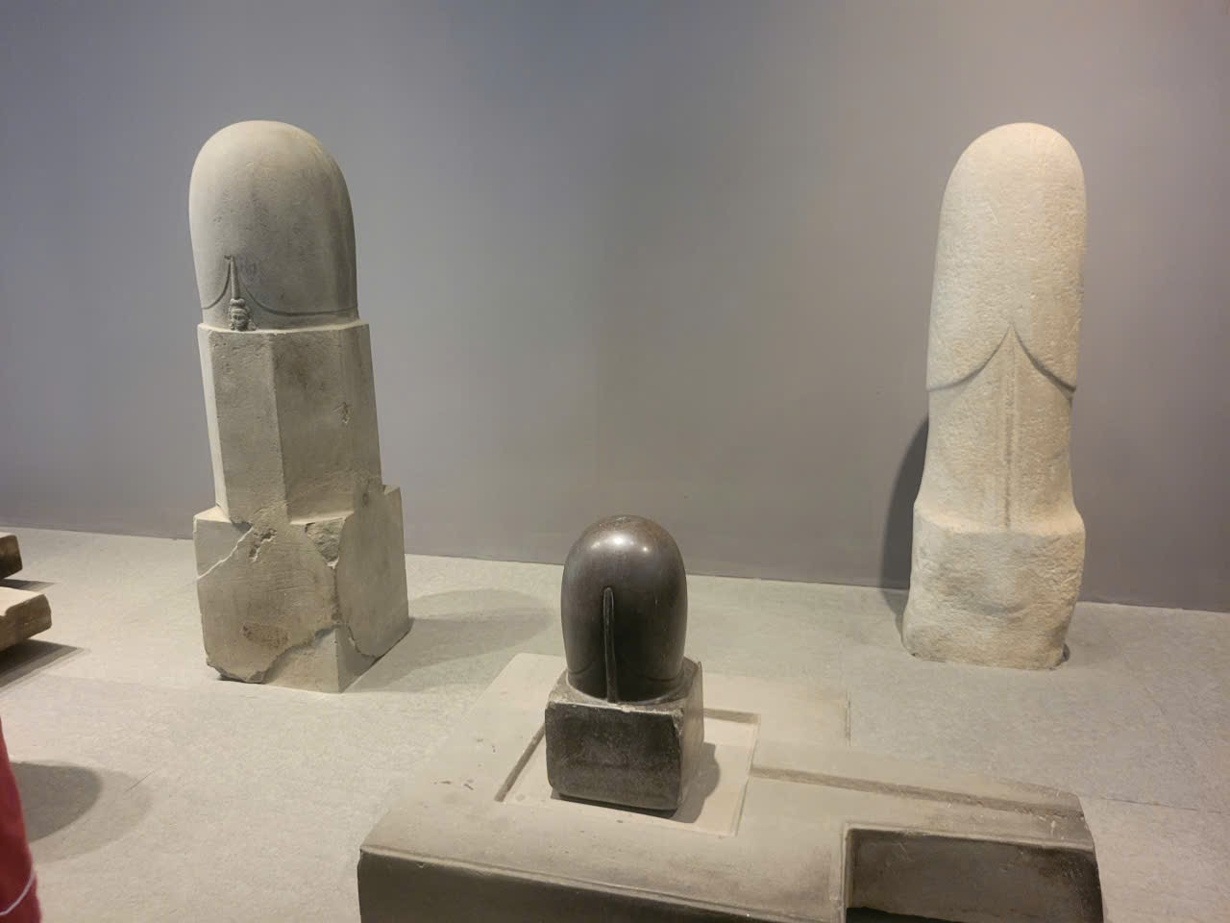
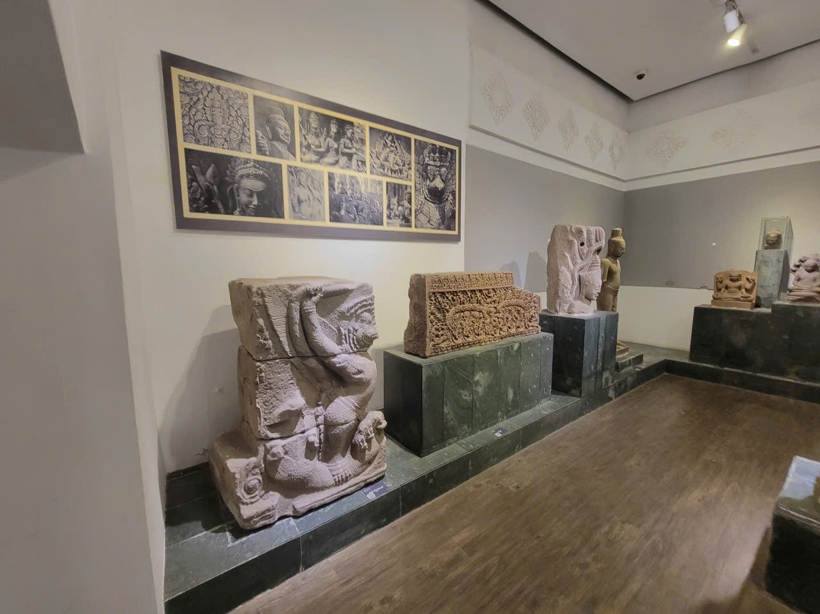
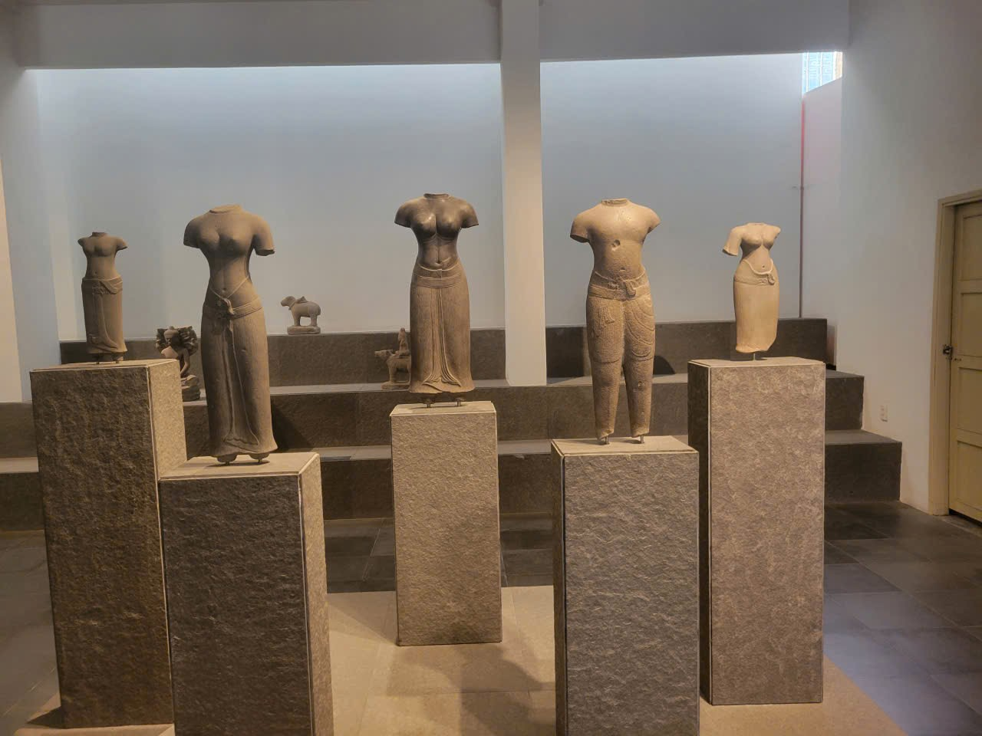
Oc Eo culture
Time: First century – VII
Characteristics: Ancient culture in the South, international trade exchange.

Slide 20
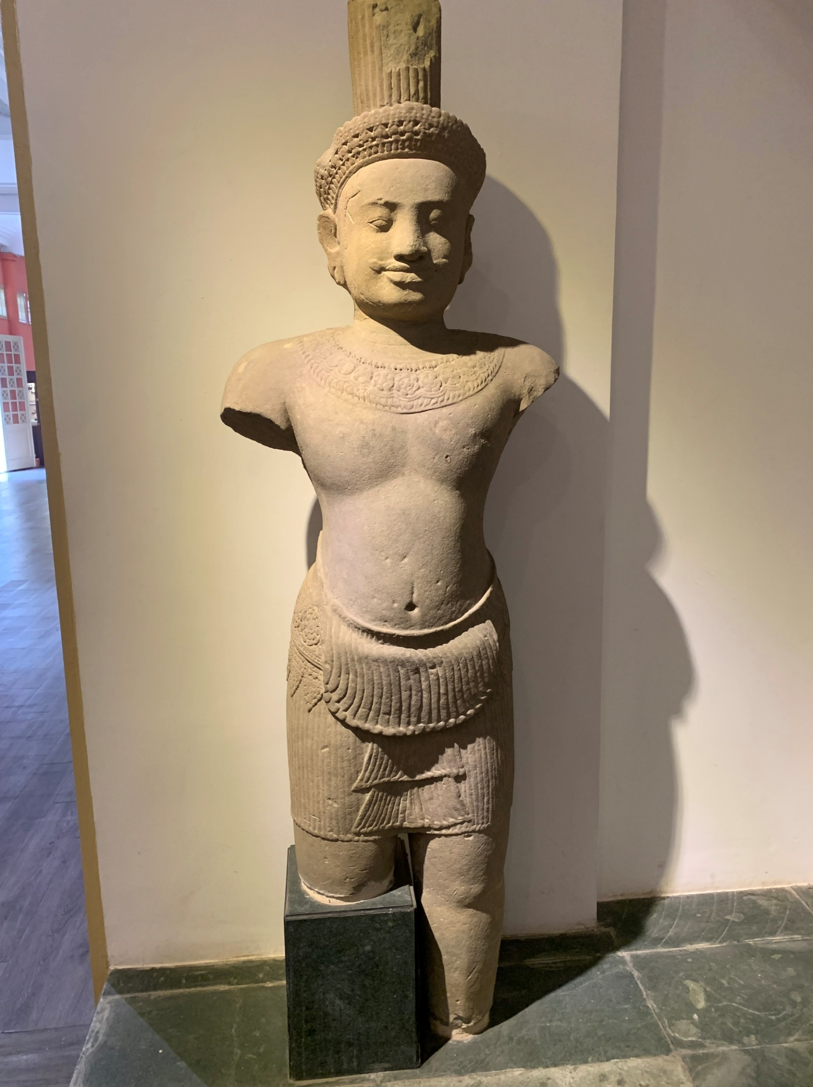
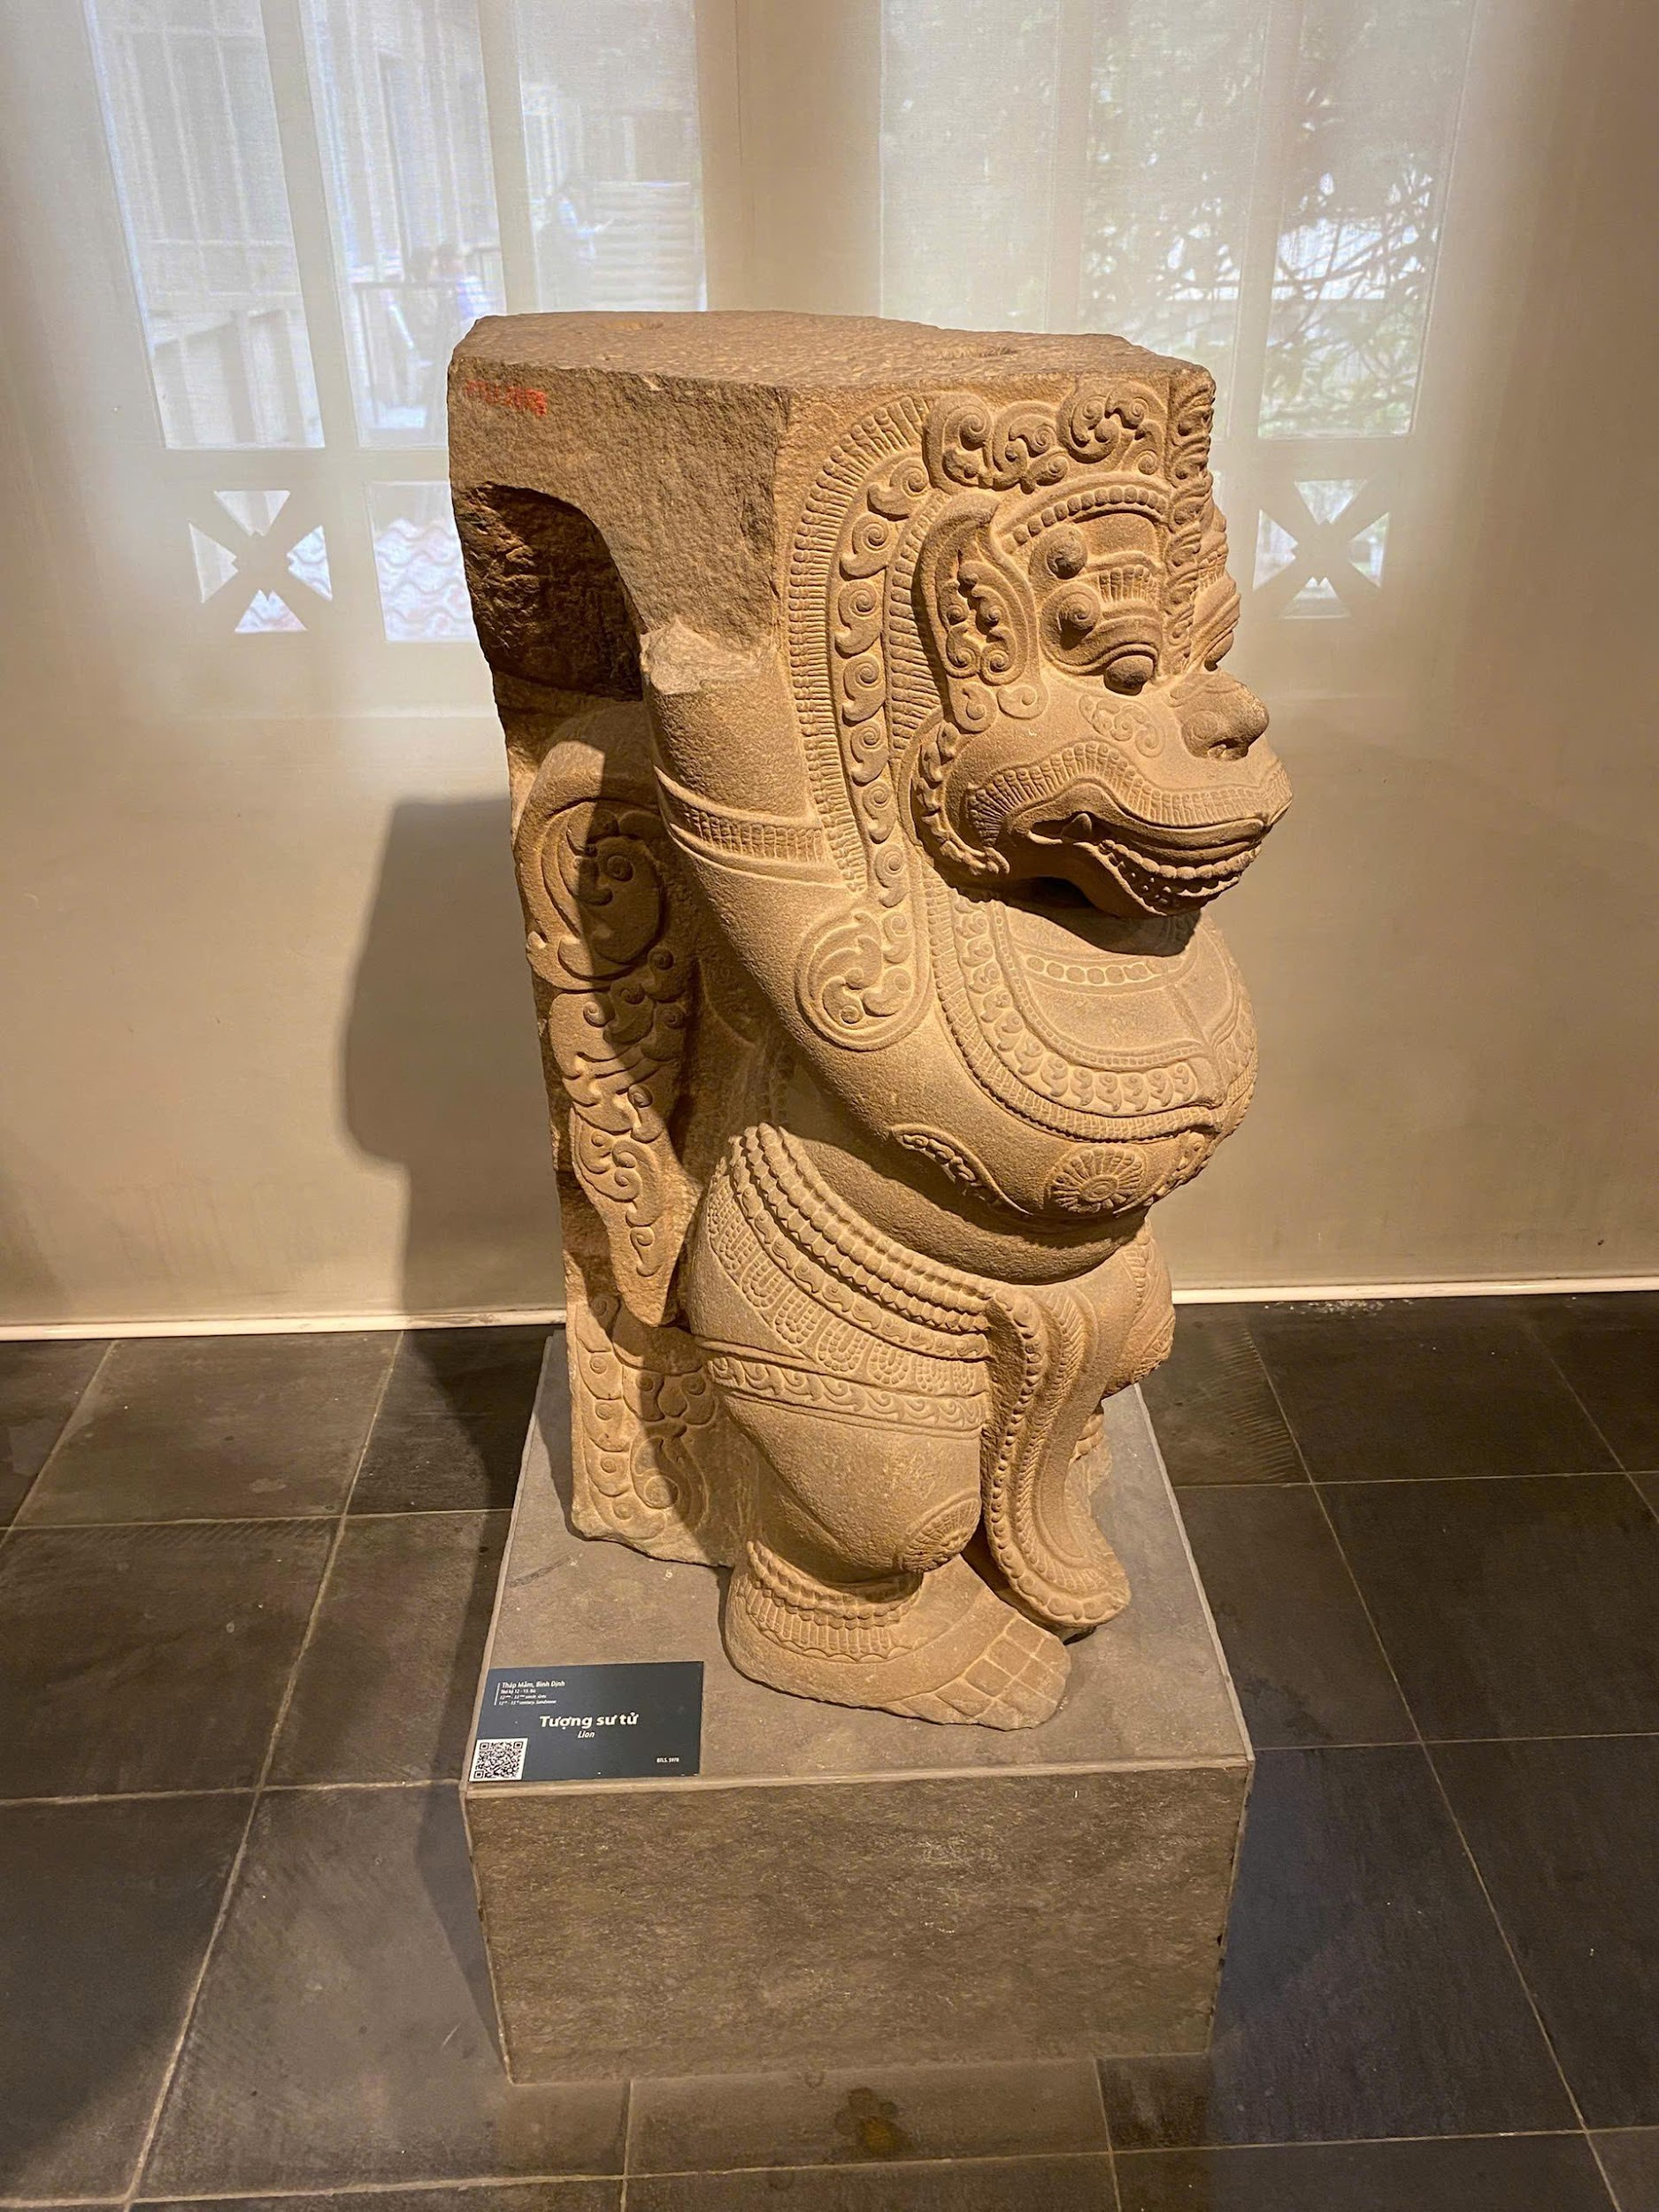
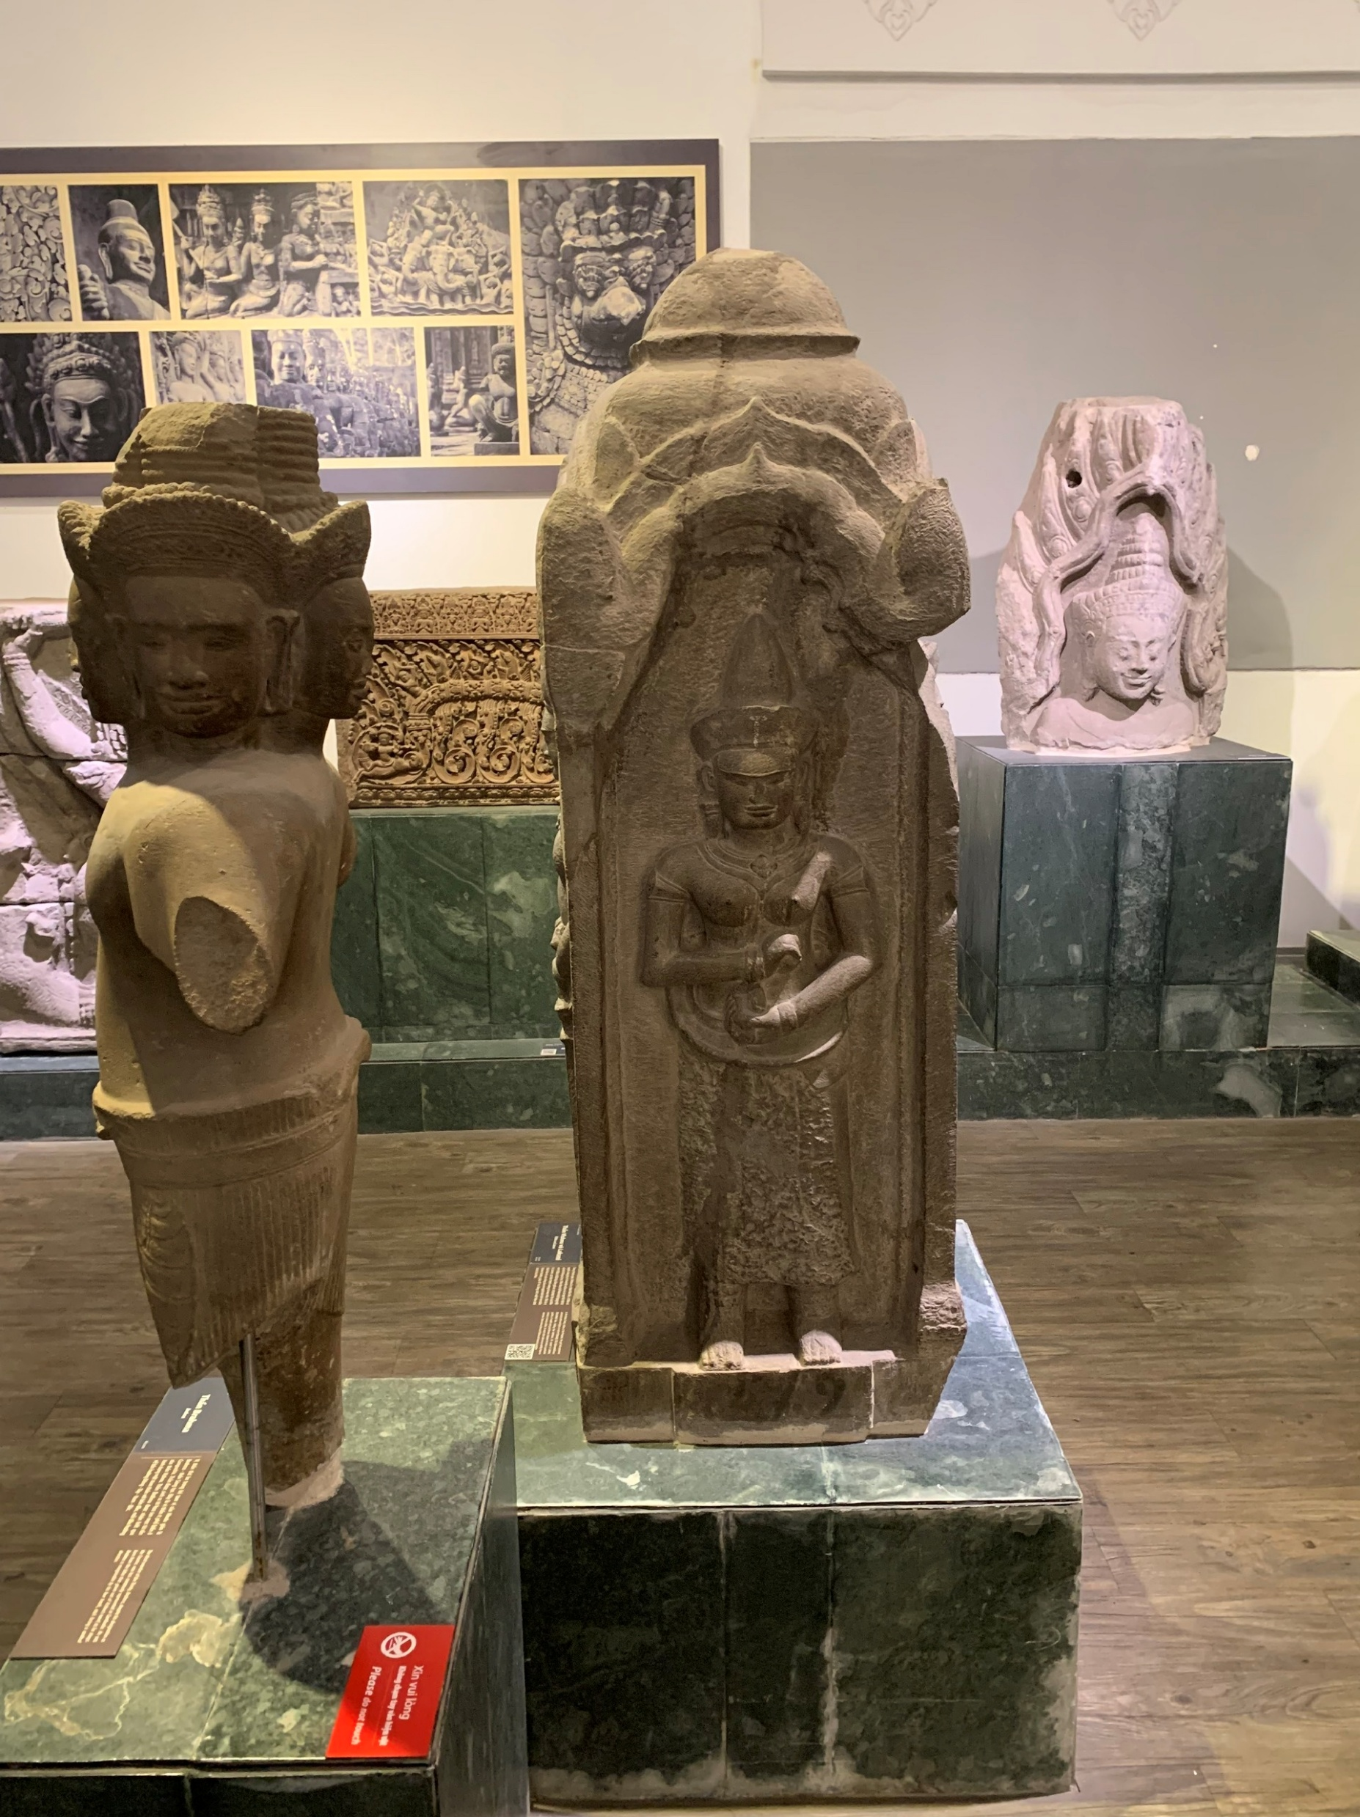
Stone carvings of Cambodia
Characteristics: Khmer art, Angkor heritage influence the Southern region..

Slide 21
Maritime trades – Shipwrecked ceramics
Characteristics: Vietnamese ceramics on international trade routes.

Slide 22
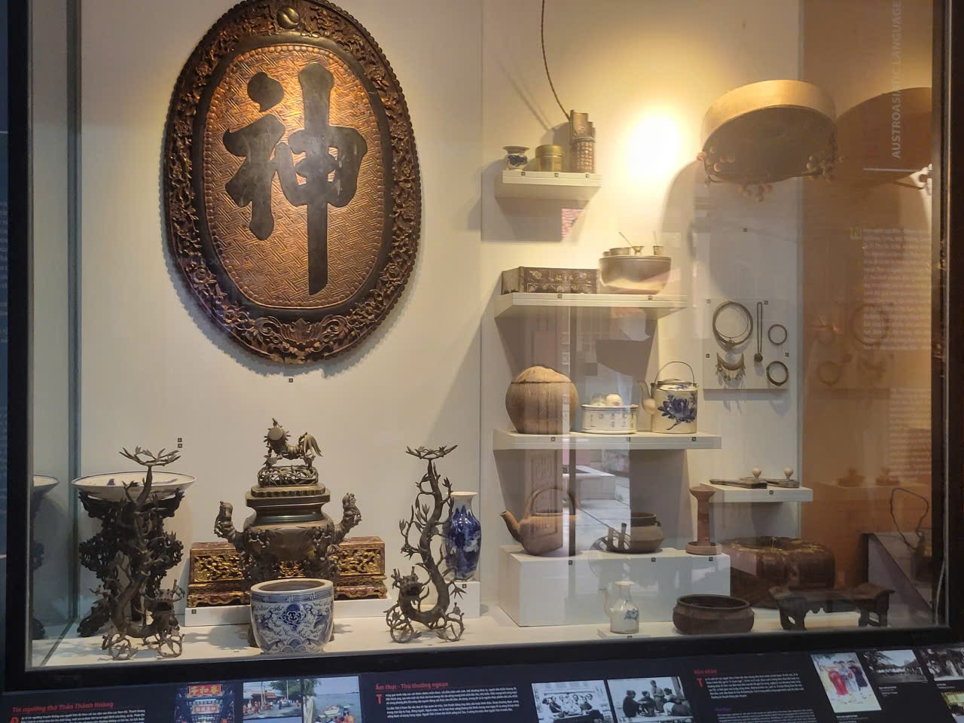
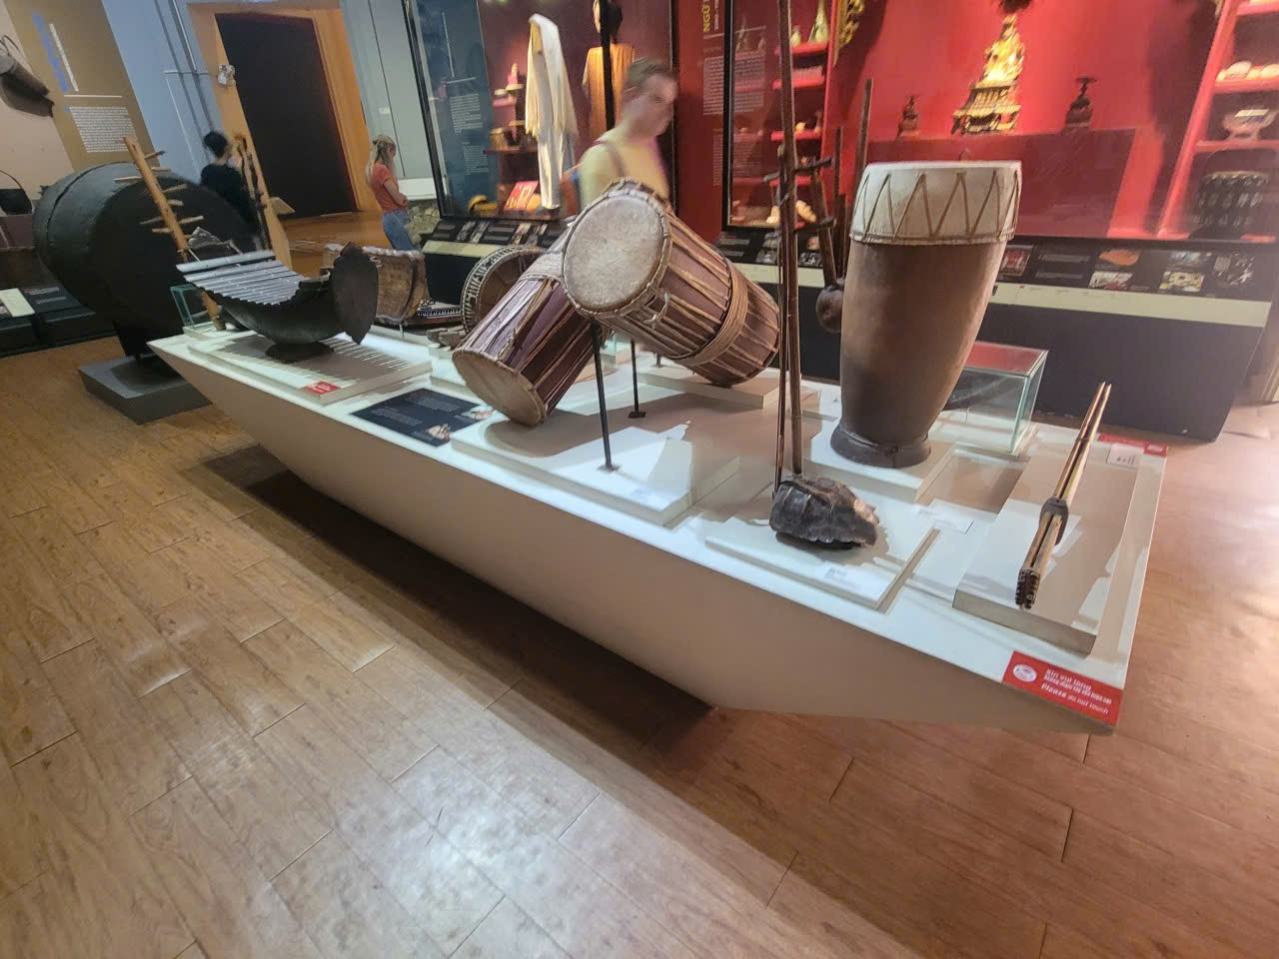
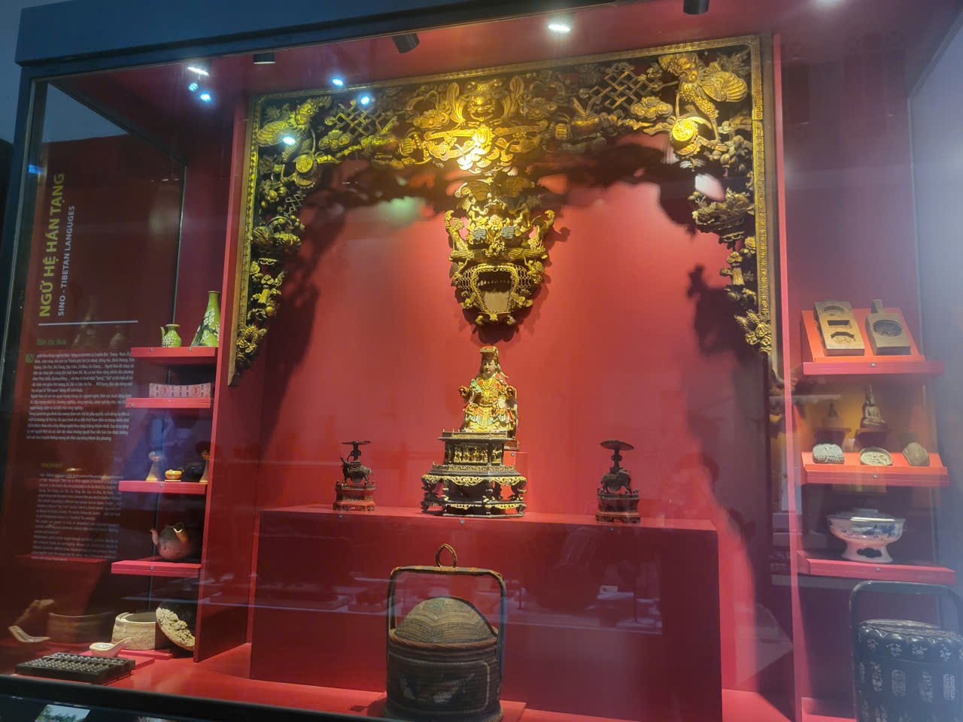
Minority cultures from Southern provinces
Characteristics: Khmer, flower and Cham culture in the South.

Slide 23

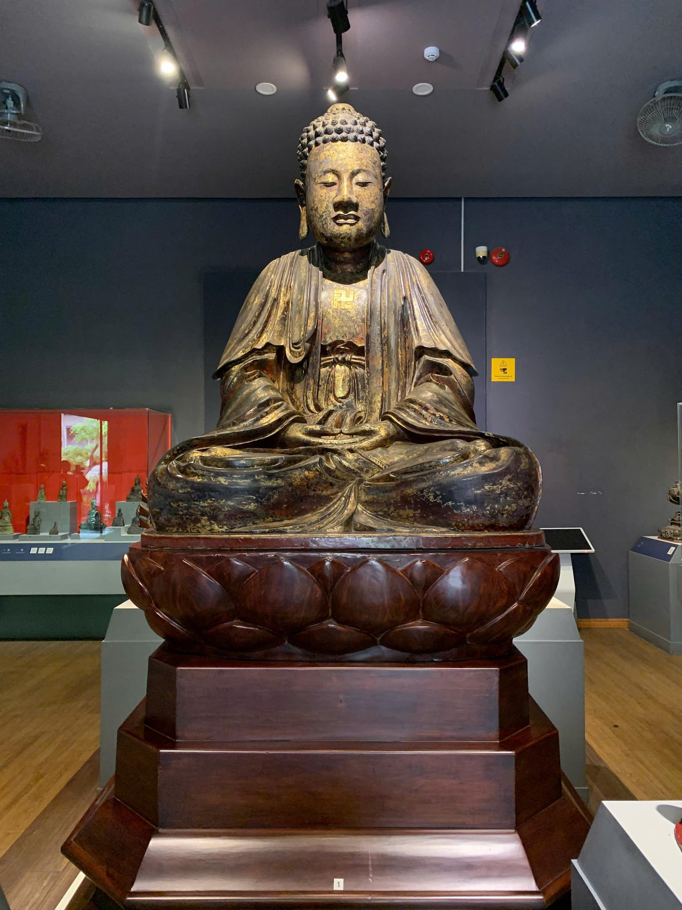
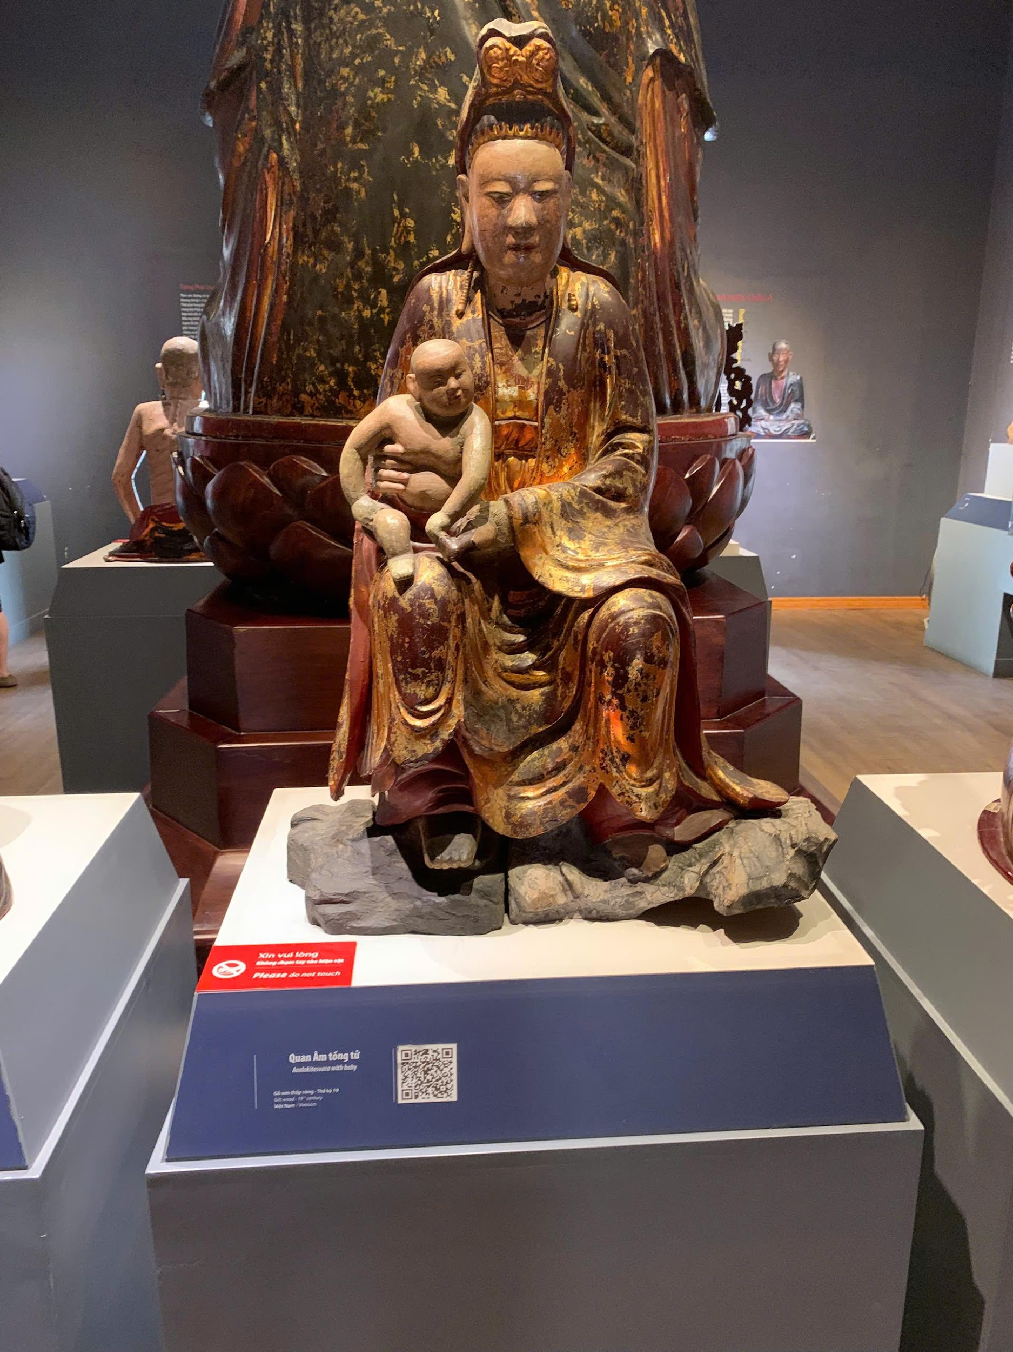
Buddhist Statues of Asian countries
Characteristics: Regional Buddhist art, Vietnamese culture influence.

Slide 24
COLLECTION

Slide 25
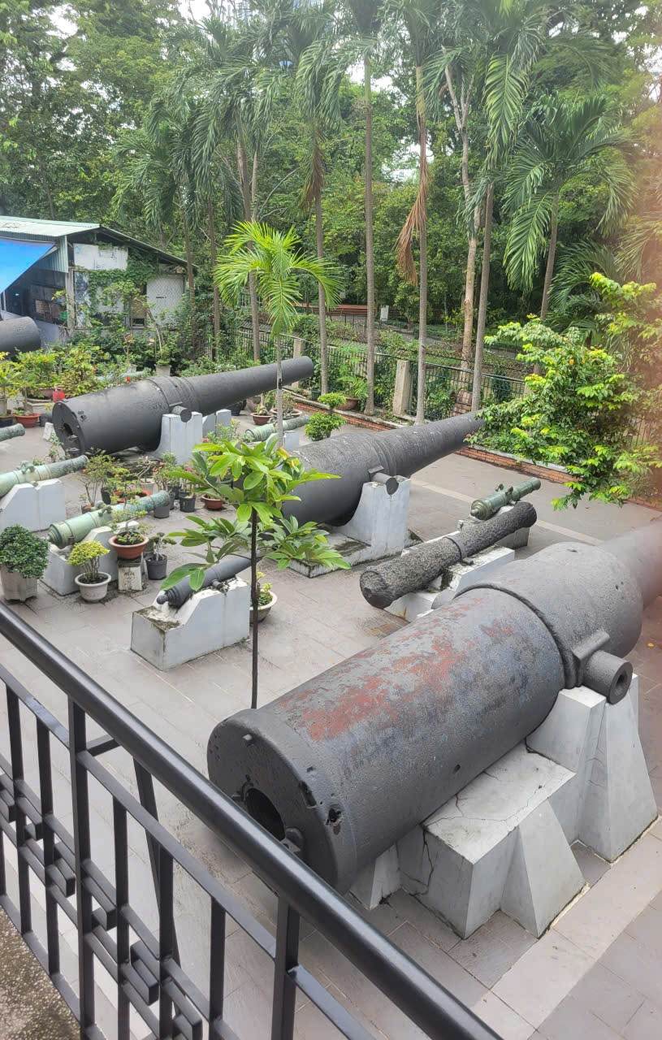
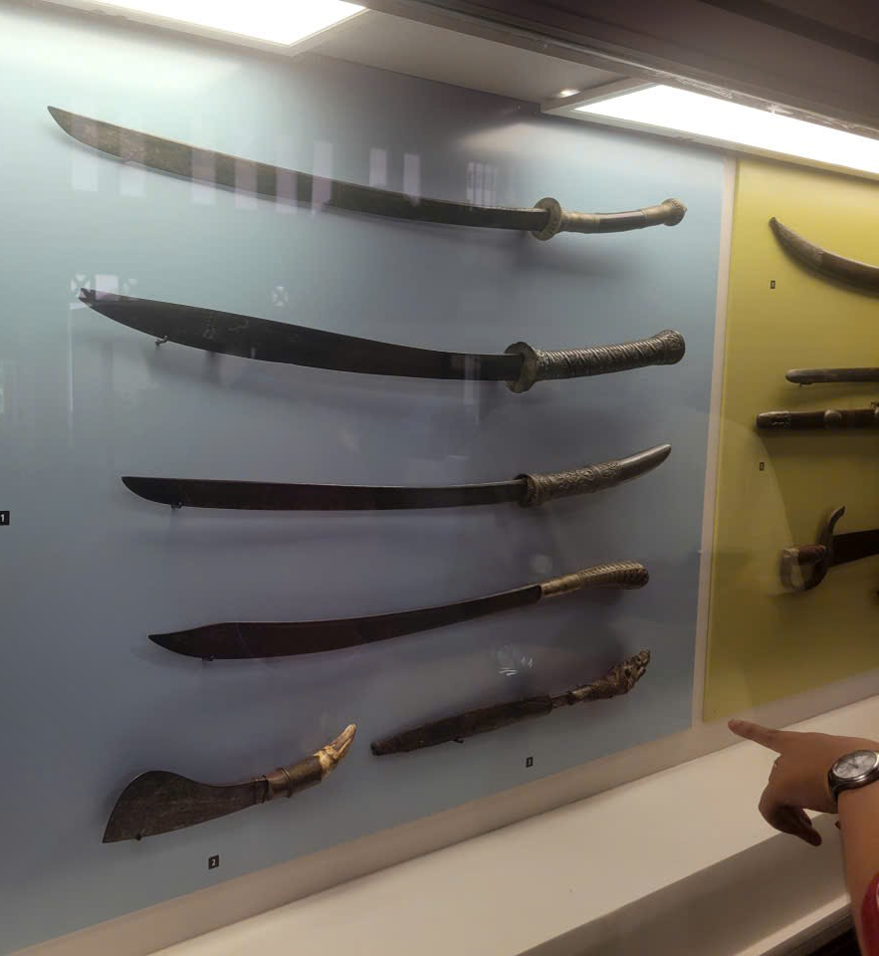
The Cannons
Time: 17th – 19th century
Characteristics: Gun from the Nguyen Dynasty

Slide 26
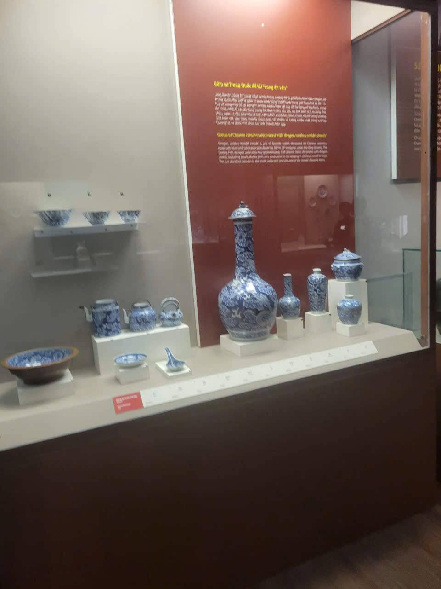
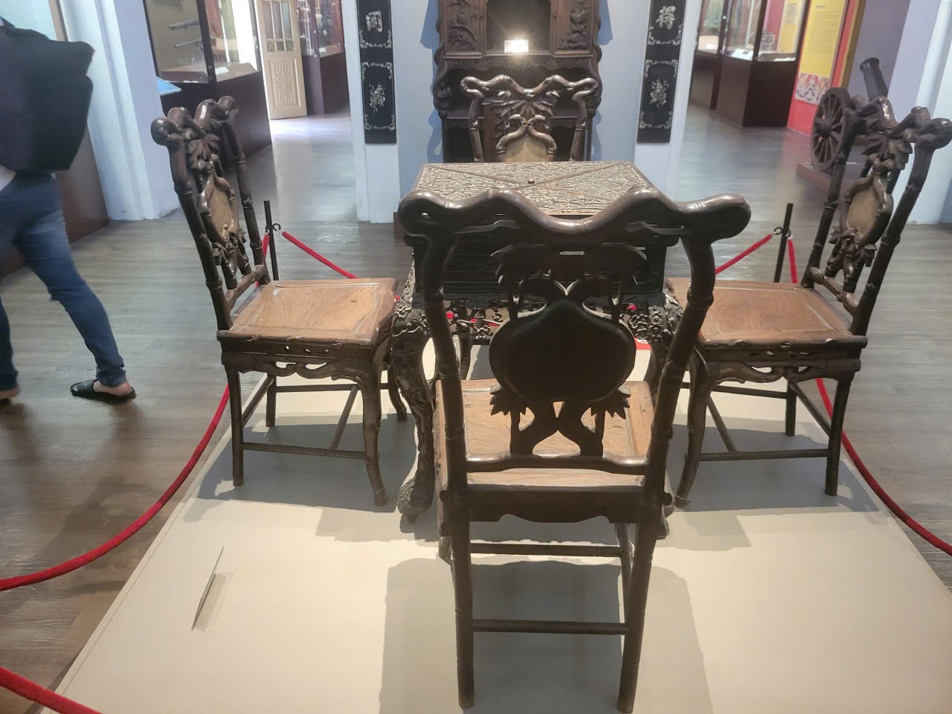
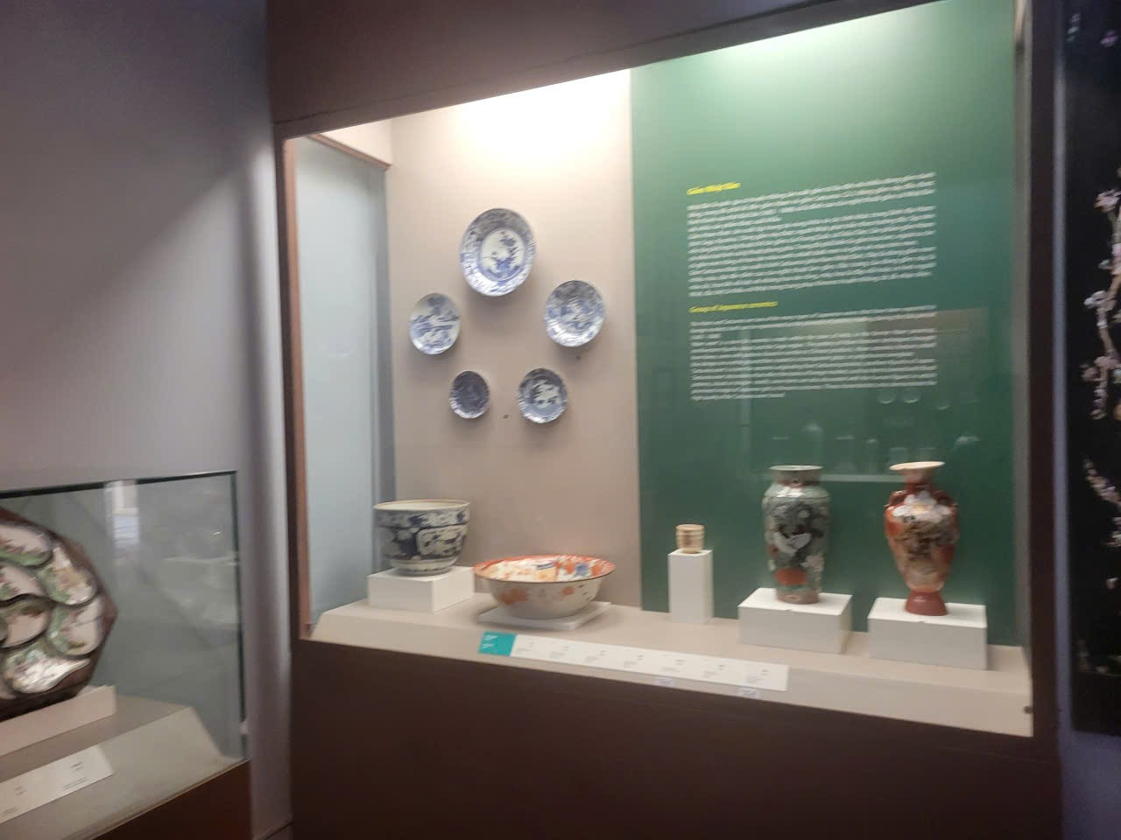
Duong Ha Collection
Characteristics: Including many different periods from prehistoric times to the Nguyen Dynasty

Slide 27
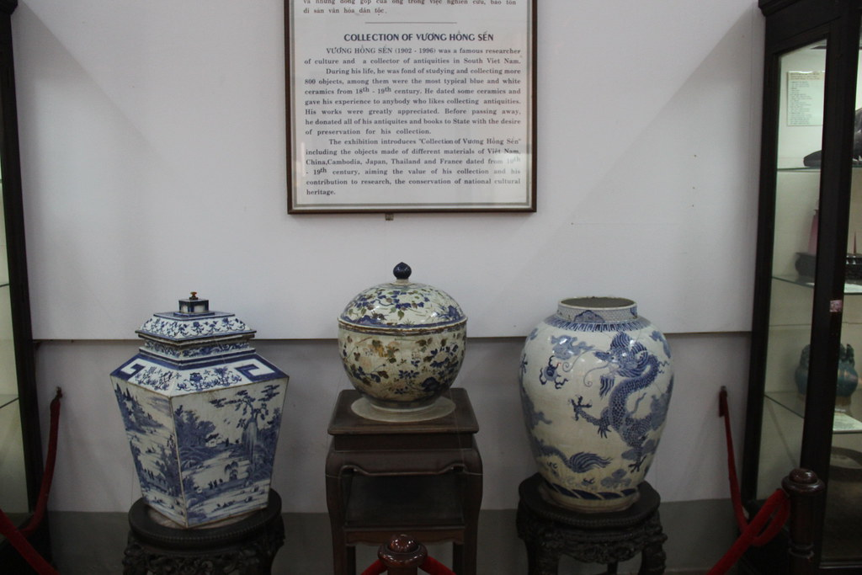
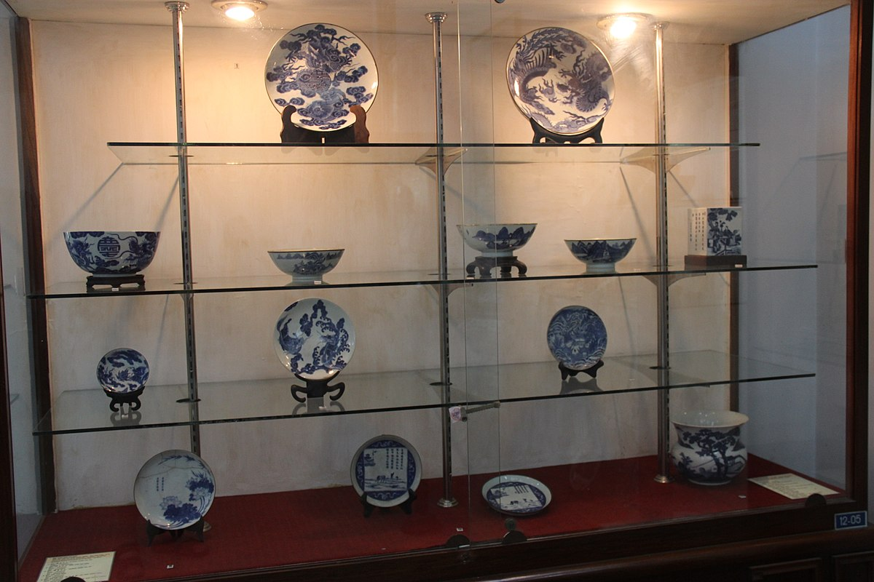
Vuong Hong Sen Collection
Characteristics: Including antiques, ceramics, folklore from many historical periods

Slide 28
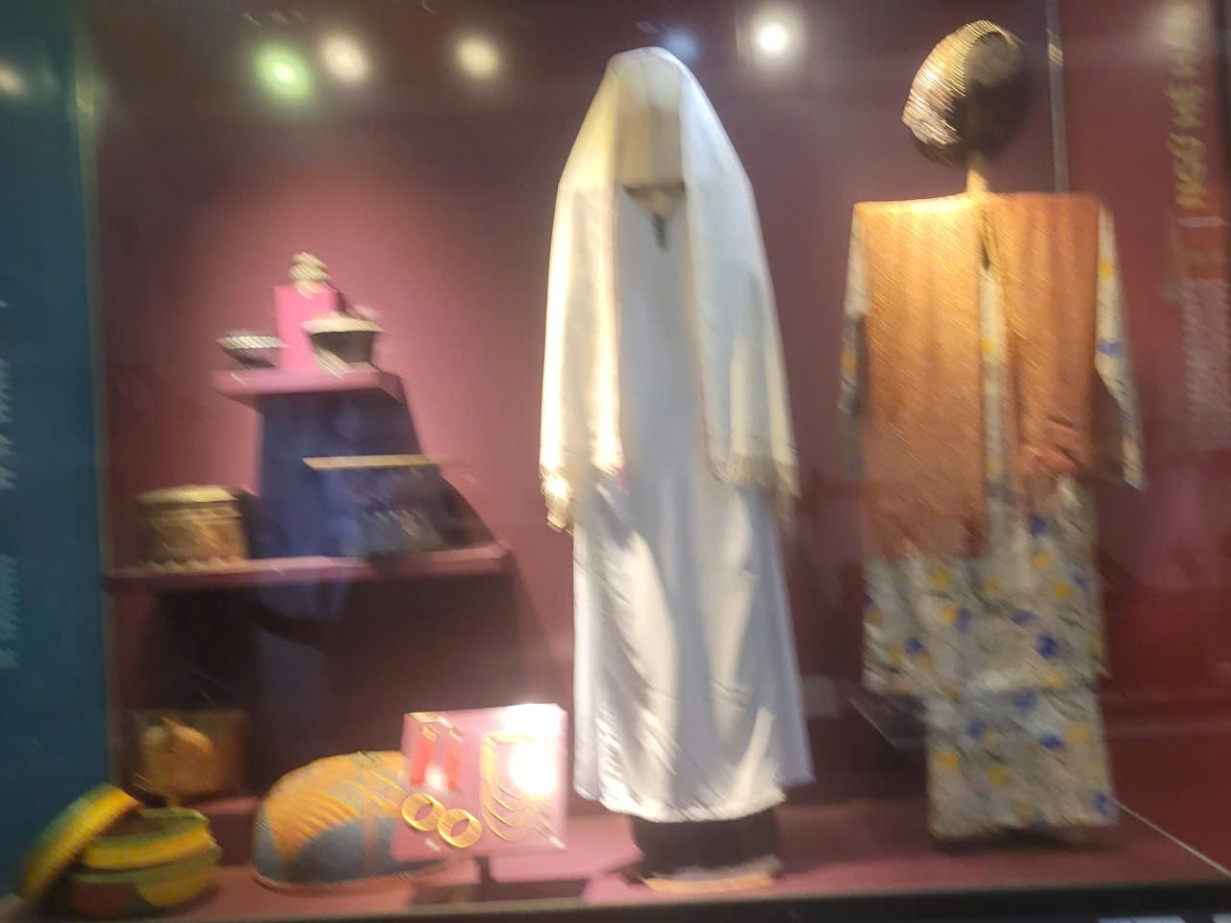
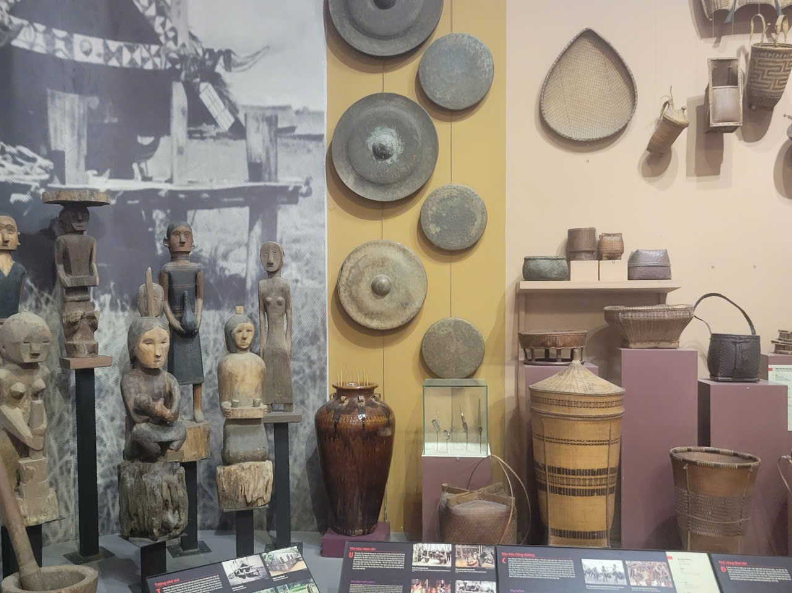
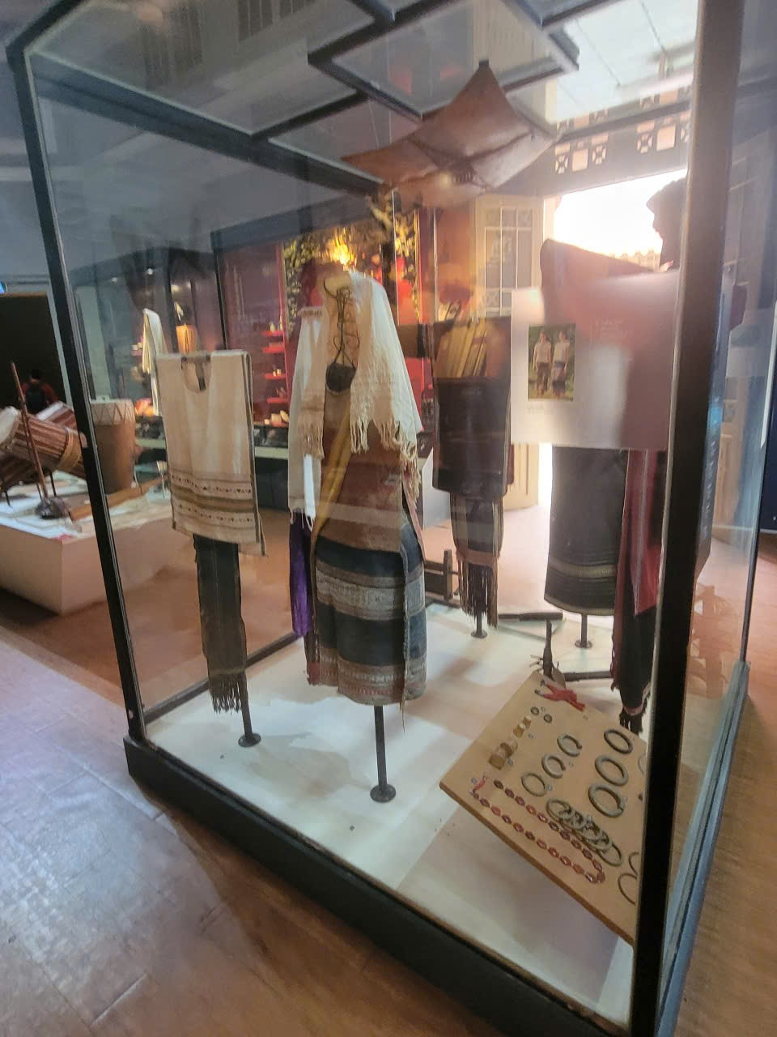
Temporary Exhibition
Characteristics: Temporary exhibition, change by topic, not associated with a specific historical period

Slide 29

Q&A
Thank you
Intern | Vo Tran Quang Thong

Slide 31
bbv template EN
How-to guides

Slide 32


bbv Master layouts & slide library
Insert new slide
1
Click on «New Slide»
1
2
Select layout
Choose the desired layout from the pre-programmed master layouts.
2
🡪
Or select layout from slide library

Slide 33




Transfer of existing slides into the new Master
1
2
3
4
Insert original slide
Copy slide in original presentation with Ctrl+C.
In the target presentation, select the slide after which the original slide is to be inserted.
Select in the tab «Home / Paste / Use Destination Theme».
Assign slide layout
Select the inserted slide
Select the desired layout in the tab «Home / Layout».
Adjust slide manually
Check all slide contents such as text blocks, images, etc. for position and size and manually adjust them to the new layout grid.
Check design
Independently check:
Font type, sizes and font colours
Colours of graphic elements
Text alignment
Coherence of the overall picture
Important:
When transferring existing slides, always carry out all four steps.

Slide 34


Change icon colour
Approach
Notes
Select icon
In the tab «Graphics Format» under «Graphics Styles», use «Graphics Fill» to change the colour
For some icons, the colour can be changed by using «Graphics Outline» instead of «Graphics Fill».
The colour cannot be changed if an icon is inserted as a picture. In this case, after selecting the icon, the tab «Picture Format» appears instead of «Graphics Format».
Best vector file format for icons: *.svg

Slide 35






Insert image into placeholder
Insert image from external source
Click on the image icon, select image from Sharepoint or other source
The bbv image library is here locally located: C:\Users\Public\bbv_templates\Marketing\PPT-Bibliotheken\Bilder-Bibliothek
Or: copy image from external source with Ctrl+C, select the placeholder, then paste with Ctrl+V
Adjust
Select the image
Click in the tab «Picture Format» on «Crop»
Adjust the image composition by moving the image
Resize the image by clicking and dragging the outer circles.
Click again on «Crop» to finish the adjustments

Slide 36






Insert image into mock-up screen (mobile/laptop)
Mock-up
Paste image
Copy image from external source with Ctrl+C and paste with Ctrl+V
Image mask
Adjust size & determine image area:
Place image behind image mask
Adjust image size and determine image area
Image mask
Crop image to image mask
Select image
Select image mask
Click in the tab «Shape Format / Merge Shapes» on «Intersect»
Combine image with mock-up
Place image behind mock-up
Activate image and mock-up and align both horizontally (Align Center) and vertically (Align Middle)
Group image and mock-up with Ctrl+G

Slide 37
bbv template EN
Style guide

Slide 38



Working area, guides & ruler
Working area
Depending on the slide, a single-column layout, a 2-column or 3-column layout is used.
Display the ruler and guides in the «View» tab.

Slide 39


bbv colour theme
Always OK!
Never, please!
Default text colours
Main accent
Colours for diagrams, charts, graphs etc.
Use selectively and sparingly
Never, please!
Colours for diagrams, charts, graphs etc.
Colours for diagrams, charts, graphs etc.

